Slide 1

More than a dropped objects
All images used in this moment were shared by OEUK/Police Scotland

Slide 2
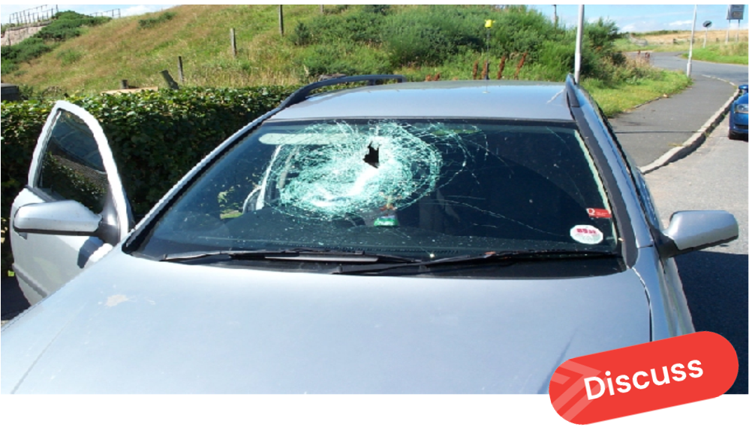


More than a dropped object
A woman and her child were in this car.
How might your actions in the offshore workplace directly cause this?
Notes:
A woman with her child in the back seat were travelling in this car from Peterhead to Aberdeen along the A90.
As it approached the bends at Hatton, a lorry passed, going in the opposite direction.
The car was travelling at approx. 50 mph, the lorry about 35-40mph.
As the lorry passed, a loose object fell from it and went through the windscreen.

Slide 3
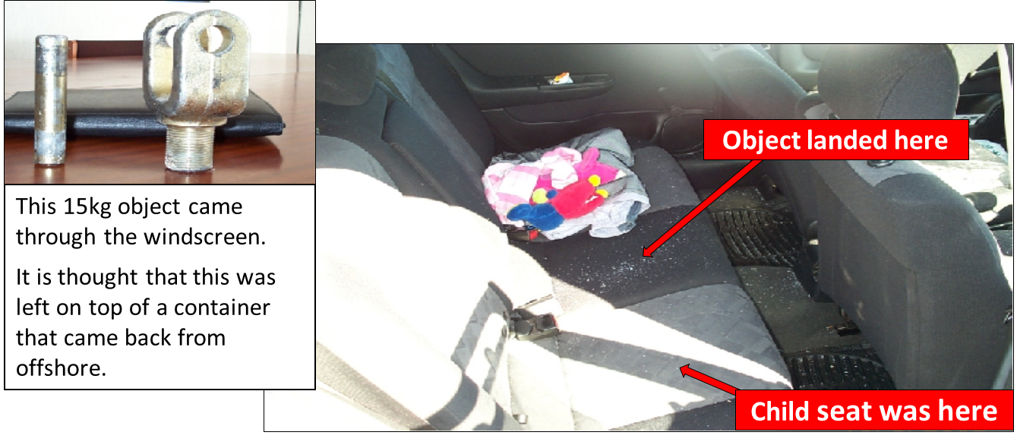

More than a dropped object
How would you feel if this landed next to your child?
How do you ensure that you are not responsible for an incident such as this?
Notes:
The object in the smaller picture went through the windscreen, narrowly missed the driver, and landed in the back seat next to her child who was strapped into a child seat. The driver received minor cuts to her face from flaying glass and the child was unhurt. Luck was on their side.

Slide 4

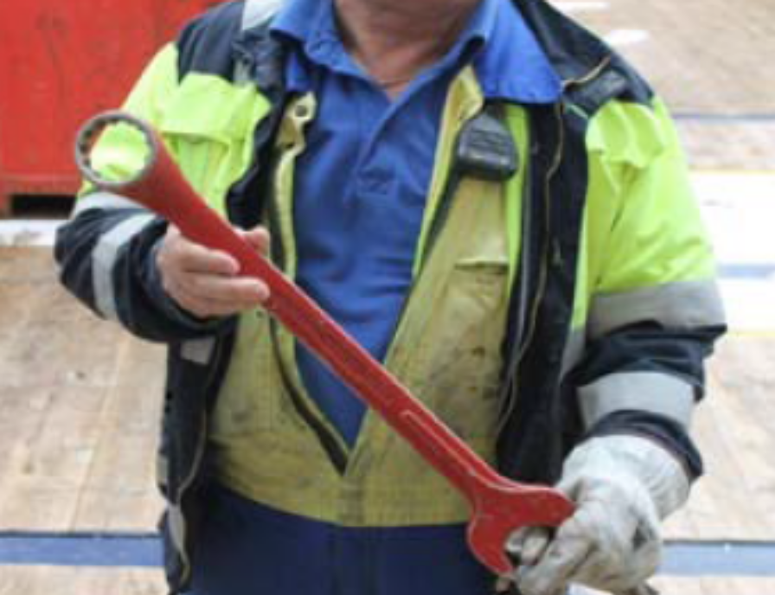
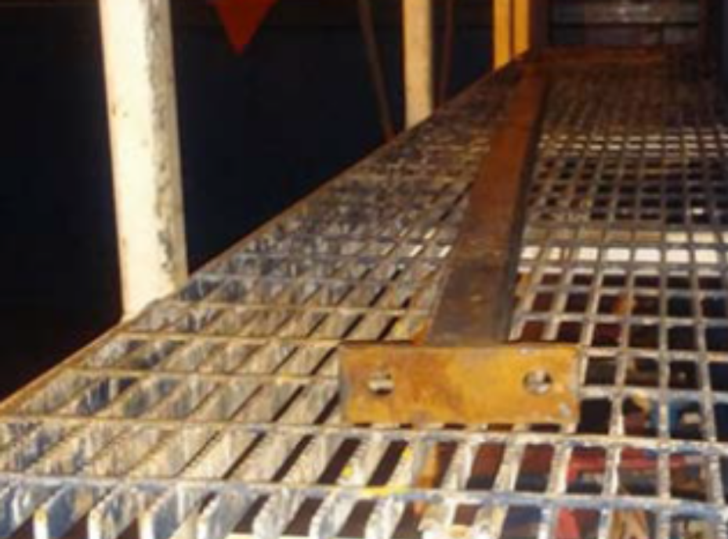
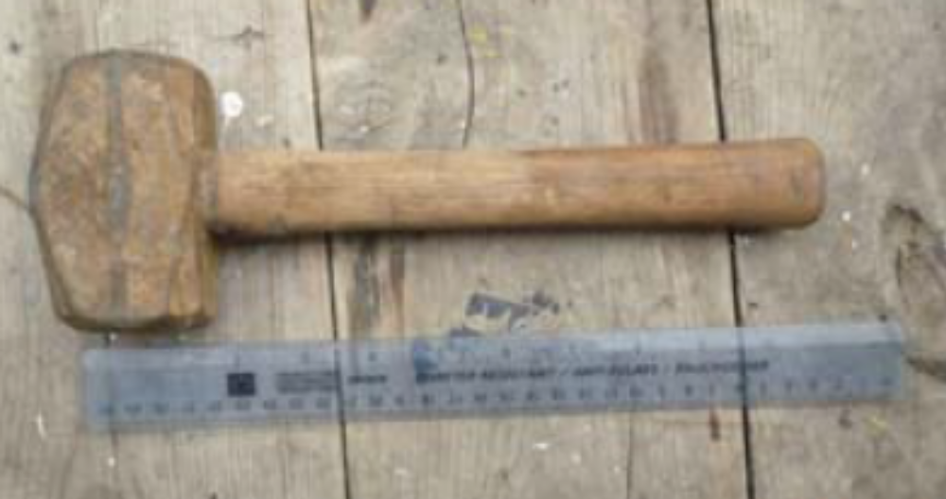
More than a dropped object
Examples of dropped and potential dropped objects during transportation
Notes:
This data is from one supply vessel operator.
These objects were discovered during or after transportation.
The number of dropped objects (reported to one supply vessel operator) in 2015 was 19. This has increased in 2016, despite a reduction in the fleet.
The breakdown of the origin of the dropped objects remains broadly unchanged, year in year.

Slide 5
More than a dropped object
Causes of dropped and potential dropped objects:
Objects left unintentionally and not found before transportation
Unsecured items missed during pre-lift checks
Items detaching as a result of colliding with other cargo or vessel/lorry
Help and advice:
Pre-transportation checks must be undertaken and given high importance
People responsible for loading and transportation must be observant and ensure loads are secure
Everyone must remain in a safe area, clear of lifts until the cargo is landed
All dropped and potential dropped objects must be reported to the installation and vessel owner

Slide 6
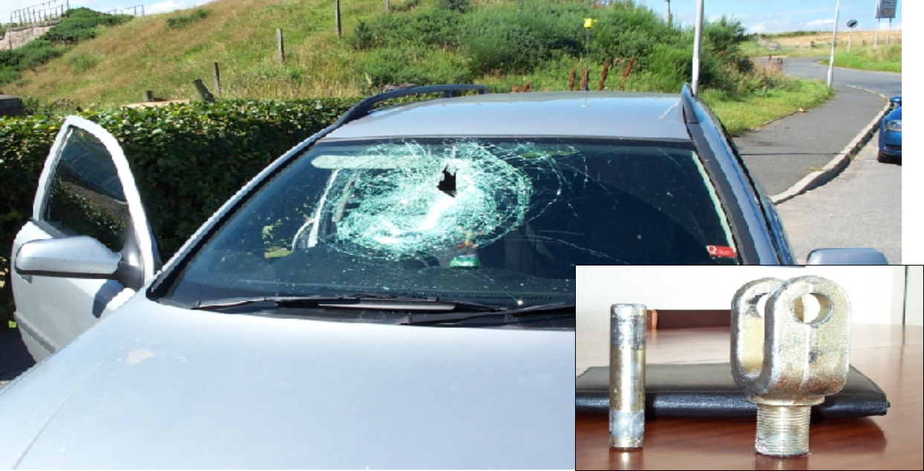
More than a dropped object
This object became a missile when it flew off a lorry at speed

Slide 7
More than a dropped object
Which of the 7Cs are involved in this safety moment?
Change management
Communication
Complacency
Control of work
Competence
Culture
Commitment

Slide 8

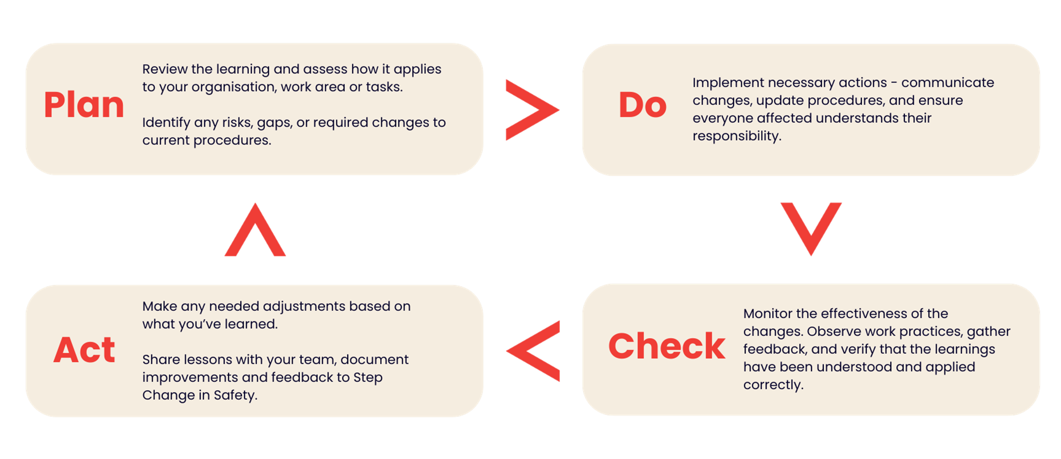

Verification of learnings shared and feedback
To ensure this learning leads to meaningful improvement, follow the Plan Do Check Act process and provide your feedback to Step Change in Safety.
Share your learnings and feedback. Your proactive engagement helps create a safer workplace for everyone.
Link to Resource Feedback Form

