Slide 1

HP Riser Disconnect Process Flow
September 2011

Slide 2
HP Riser Disconnect Process Flow
Plan to reduce the 3,500psi to 3,000psi via hot stab

Slide 3
Background
Drilling operations were progressing on a subsea development in the CNS utilising a JU and surface stack with a flanged HP riser and a H4 wellhead connector
Operating parameters stipulated (by supplier) that +/- 3000 psi must be locked in and maintained in the H4 connector
Thermal expansion caused this pressure to increase
Decision made to reduce the pressure in the lock chamber of the H4 back to +/- 3000 psi
Connector would remain locked even with zero pressure in the lock chamber

Slide 4
Operation
Due to raised pressure in lock chamber of a HP Riser connector, ROV was fitted with a hot stab and deployed.
The intention was to open the connector lock (CL) chamber isolation valve and equalize/reduce the pressure in the connector lock chamber to 3,000psi. Once the hot stab was installed into the ROV panel the ROV operator turned the CL valve to bypass mode, it was at this point the pressure showing in the CL chamber immediately dropped from 3,500psi to zero.
The ROV then operated the Connector Unlock Valve (CUL) in line with the supplier’s procedure to verifiy there was no trapped pressure in the unlock chamber. As the CUL valve was moved from Normal mode to bypass mode the riser unlocked.
No discharge was noted from the riser.
The ROV was recovered to surface where upon inspection it was found that the hot stab pressure supply hose had been plumbed up incorrectly

Slide 5
Planned Event
Plan to reduce the 3,500psi to 3,000psi via hot stab

Slide 6
H4 Connector
Locking dogs

Slide 7
Planned Operation
Connector Lock 3,500
Piston
3,500psi
Unlock
CL Closed
Hot stab inserted into receptacle.
3000psi present in connector lock line.
3,000psi from ROV
CUL Closed

Slide 8
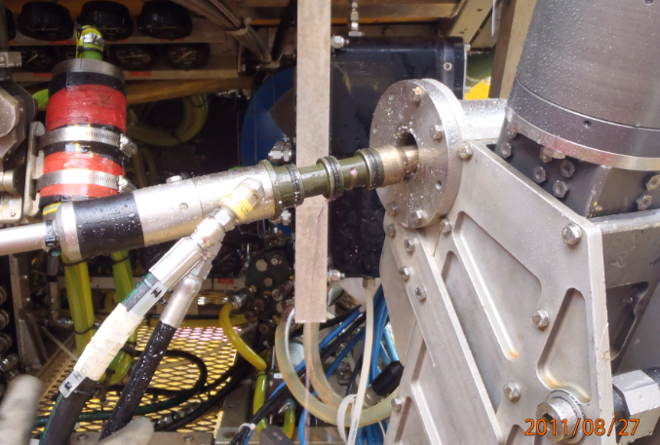
Hot Stab
Supply/return hose
Fluid output
Seals

Slide 9
Planned Operation
3,500psi
Connector Lock 3,500
3,500psi
Piston
Unlock
CL v/v opened on connector lock line.
3,500psi on connector lock would equalise with the 3,000psi applied via hot stab.
CL Open
3,000psi
CUL Closed

Slide 10
Planned Operation
Connector Lock 3,000
3,000psi
Piston
Unlock
Expected condition after opening CL v/v.
Pressure equalised across the connector 3,000psi
Pressure on connector reduced to 3,000psi
CL Open
3,000psi
CUL Closed

Slide 11
Actual events
Unplanned disconnect of H4 connector

Slide 12
Actual Operation
3,500psi
Connector Lock 3,500
3,500psi
Piston
Unlock
3,000psi was actually applied to the CUL line due to the hot stab being incorrectly plumbed
CL Closed
3,000psi
3,000psi
CUL Closed

Slide 13
Actual Operation
3500
0psi
Connector Lock 0 psi
0
0psi
Piston
Unlock
When CL v/v was opened the pressure in the connector lock chamber bled to zero.
Pressure 3,000psi remained in the connector unlock line.
CL Open
3,000psi
3,000psi
CUL Closed

Slide 14
0psi
Connector Lock 0 psi
Piston
Unlock 3,000psi
0psi
When the CUL v/v was opened the 3,000psi supply pressure was applied to the connector unlock chamber resulting in the connector unlocking releasing the riser
3,000psi
CL Open
3,000psi
3,000psi
CUL Open
Actual

Slide 15
Causes
No formal procedures in place for pressure testing/function verification of hot stab.
The pressure testing/function verification of the hot stab, following fitting of the hot stab hoses, was insufficient as it was not possible to identify the flow direction of the feed. The pressure test conducted only confirmed there was no leak in the system

Slide 16
Causes
Procedures had insufficient checks and balances
The ROV operator had no means of monitoring feed pressure within the ROV hot stab system at any stage of the operation

Slide 17
Remedial actions
Reduce HP riser pressure requirement to 1,500 psi – to accommodate potential thermal expansion - agreed with riser supplier and connector manufacturer
Ensure testing protocol for verifying the flow of fluid feed from hot stab is in place
Ensure ROV operator is able to monitor pressure within hot stab system at all times

Slide 18
For further information please contact:
Barry.Fraser@eon-ruhrgas.co.uk

