Slide 1

Engagement Moment
“Fix the printer”
Disclaimer: this safety moment is designed to prevent similar incidents occurring. All guidance herein is provided in good faith and Step Change in Safety nor its member companies accept responsibility for any inaccuracies or omissions contained within this safety moment.

Slide 2
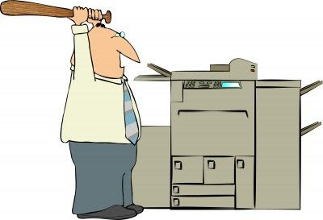
Printer in the locker room (which doubled as the permit control facility) had been broken for approximately 4 months
OIM was not aware of the issue as he uses an alternative printer
Does this seem trivial? What could be the consequences?
DISCUSS
Fix the printer

Slide 3
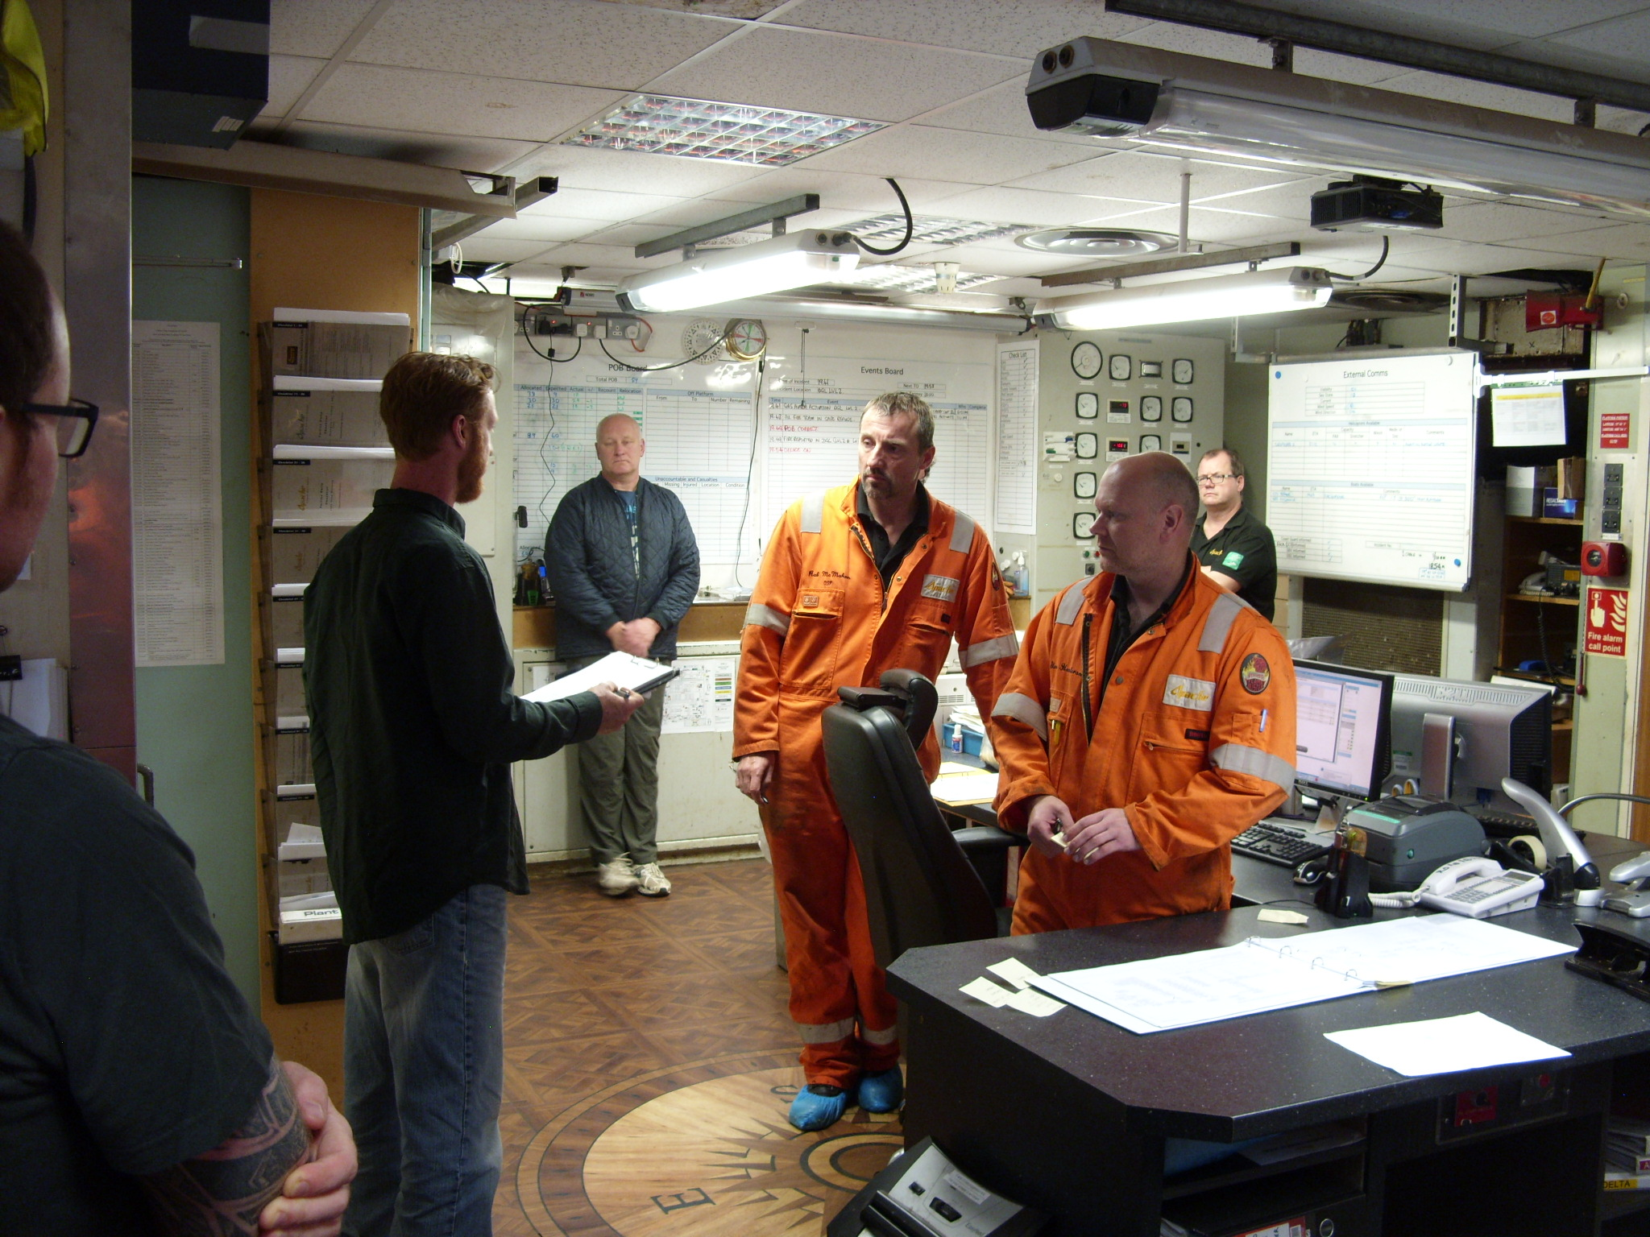
What were the consequences:
After their worksite visit, guys had to remove coveralls and climb two flights of stairs to print permit
They felt pressure to rush their toolbox talk and get to the worksite
At a safety meeting, the OIM asked what could be done to improve morale
One guy said “fix the f&@*$£g printer”. What a revelation!!
This seemingly trivial issue had potentially serious safety consequences
So it’s important to use time for the right things…
Fix the printer

Slide 4
What frustrations are there on your site that may have a similar consequence?
What other ‘low hanging fruit’ is there to fix?
What can you do to raise these issues and help resolve them?
DISCUSS
Fix the printer
Notes:
What can we do to engage with our personnel and look for quick wins?
How do we prevent a printer being broken for 4 months (or similar) – how do you raise issues effectively to get them resolved?
How do we empower individuals to resolve issues themselves?
It is important to remain vigilant and recognise when people are potentially exposing themselves to risk as a result of perceived pressure – how many times has a supervisor asked you “why are you not on the job site yet?”

Slide 5
Good practice:
Availability of computers and printers can be an important contributor to your control of work arrangements
Trivial issues can have non-trivial consequences
Have regular conversations to ensure that appropriate issues can be raised to someone who can take action
Don’t assume someone else has raised the issue – speak up
Ensure timely feedback is given on the issues raised
If an issue is having an effect on safety, raise it with your Elected Safety Rep
Fix the printer

Slide 6
Which of the 7Cs are involved in this safety alert?
Change management
Communication
Complacency
Control of work
Competence
Culture
Commitment
Could your discussion lead to creating another alert to share with industry? Please contact : info@stepchangeinsafety.net
Fix the printer

