Slide 1

A divided opinion of risk

Slide 2
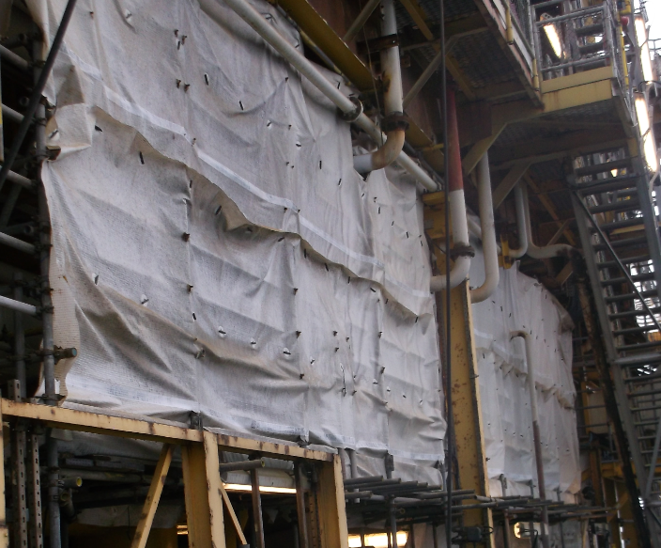

Opinion of risk
The job was cleaning and sand blasting works within a large temporarily screened area around live hydrocarbon-containing plant.
What could go wrong?
What could be the hazards to personnel?
What could be the consequences?

Slide 3
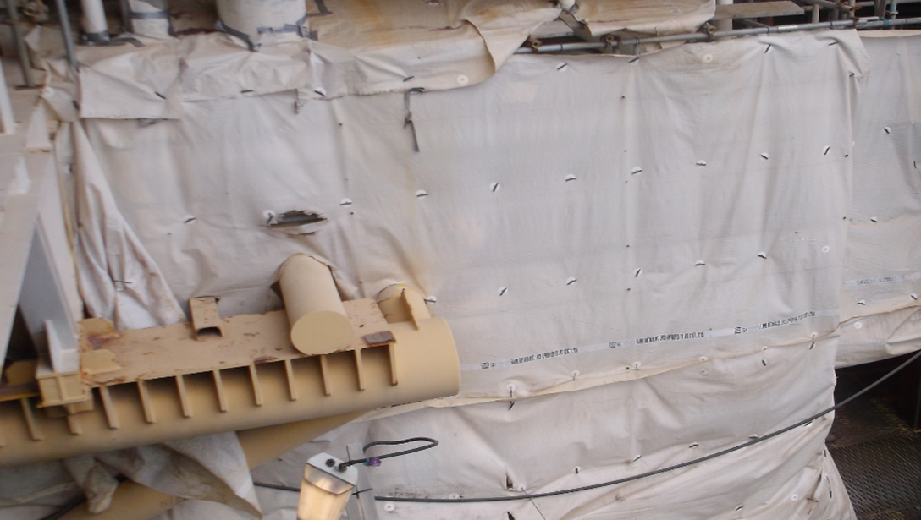
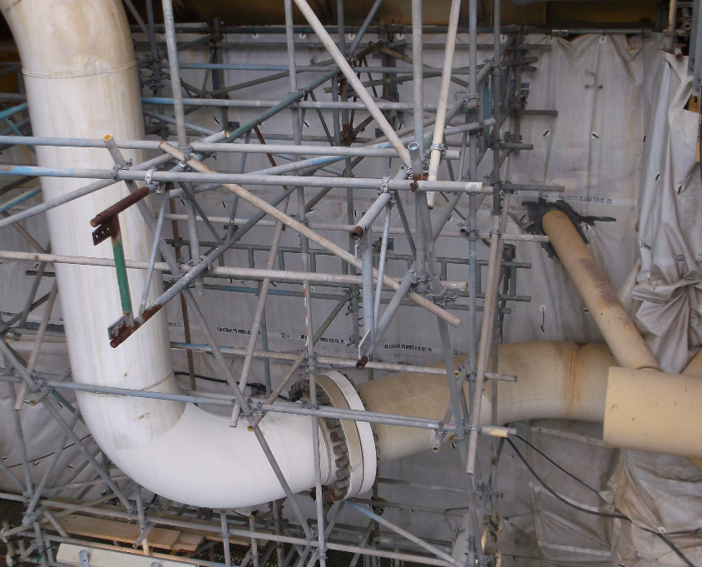
Opinion of risk
What happened
Cleaning and blasting on live hydrocarbon-containing lines
Concern that the enclosure prevented natural ventilation and allowed the potential for an explosive gas mixture
Concern was raised through the normal company channels but workers felt the issue was not sufficiently addressed. It escalated to a complaint by a Si971 safety rep to the HSE
HSE inspectors visited the installation and the complaint was upheld. All work stopped in the enclosed area
The safety rep’s actions were praised by the operator and the HSE

Slide 4
Opinion of risk
Root Causes:
The large sheeted area installed around the slugcatcher module prevented natural ventilation
An Operational Risk Assessment (ORA) was not in place to assess the risks associated with the natural ventilation being removed (PFEER requirement)
Lack of understanding of the procedures when cleaning and blasting live hydrocarbon lines
The company did not effectively provide relevant information on the risks to employees
How the issue was resolved:
The communication process for managing issues raised by safety reps has been reviewed since the breakdown between the offshore management team and safety reps
On this particular installation, a new process is now in place to manage safety critical impairments (ORAs). Also a new procedure is now in place for sand blasting and cleaning on live pipework

Slide 5

Opinion of risk
What similar situations might you face, or have faced?
In your role, what might you do differently in a situation like this?
How would we resolve this situation on our asset?

Slide 6
Opinion of risk
Which of the 7Cs are involved in this safety alert?
Change management
Communication
Complacency
Control of work
Competence
Culture
Commitment
Did this presentation result in discussion that could lead to creating another alert to share with industry? Please contact : info@stepchangeinsafety.net

