Slide 1
Safety Moment
Pipework Clamp Failure
Disclaimer: this safety moment is designed to prevent similar incidents occurring. All guidance herein is provided in good faith and Step Change in Safety nor its member companies accept responsibility for any inaccuracies or omissions contained within this safety moment.

Slide 2
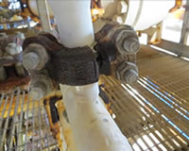
A 1” diameter pipework clamp connector catastrophically failed causing a gas release
What could have caused this?
DISCUSS
Clamp connector failure

Slide 3
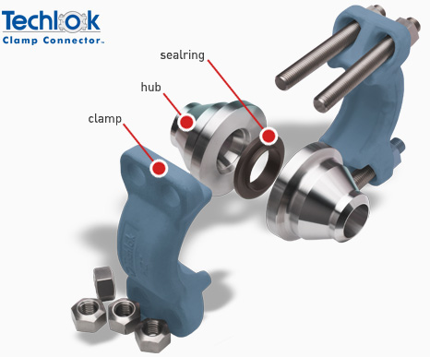
How the hub functions
The hub connector contains pressure in pipework by rigidly holding the hubs together. A sealing ring is contained inside the hubs which engages with pressure
What happened
Failure occurred due to incorrect manufacturing.
The final material properties did not meet requirements and the clamp failed.
A crack through the entire thickness of the body occurred due to the load from the bolts under tension and internal gas pressure
The incorrect material properties probably only exist in the following:
1”, 1½” and 2” diameter clamp connector segments
Manufacturer - George Dykes
Supplied prior to 2010
Clamp connector failure

Slide 4
Do you have any such hubs of 2” diameter or less on your installation – either installed or in stores?
Have they been assessed to establish if they might be at risk?
How does your organisation assure that critical equipment is delivered in accordance with specifications?
DISCUSS
Clamp connector failure

Slide 5
Help and advice
Recommendations for learning:
An HSE Alert was issued. Your company should already be acting on this alert
http://www.hse.gov.uk/safetybulletins/catastrophic-failure-of-a-techlok-clamp.htm
Is there anything else you would do?
Check that your company is aware of this HSE alert
Have you checked your stores stock?
Are technical specifications for procurement of equipment appropriate?
Is your supplier compliant with these?
Have you carried out quality checks to ensure this?
Has your supply chain seen this safety moment?
Clamp connector failure

Slide 6
Which of the 7Cs are involved in this safety alert?
Change management
Communication
Complacency
Control of work
Competence
Culture
Commitment
Did this presentation result in discussion that could lead to creating another alert to share with industry? Please contact : info@stepchangeinsafety.net
Clamp connector failure

