Slide 1
Safety Moment
Dropped object
Disclaimer: this safety moment is designed to prevent similar incidents occurring. All guidance herein is provided in good faith and Step Change in Safety nor its member companies accept responsibility for any inaccuracies or omissions contained within this safety moment.

Slide 2
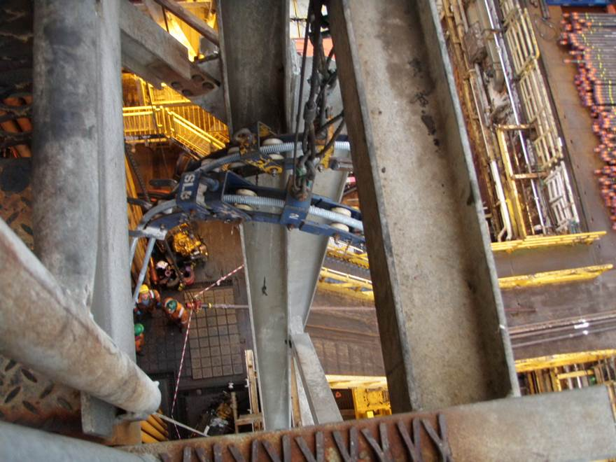
A lifting operation was in progress.
Cables were being fed from cable drums situated on the pipe deck, rising 40ft through a guide mechanism suspended from rigging, and fed back down to the drill floor.
What hazards do you see?
What could go wrong?
What might be the consequences?
DISCUSS
Dropped object

Slide 3
What happened
A hinged roller unit, weighing 10lb, dropped 40ft onto the drill floor, missing the nearest person by 4ft.
Retaining clip holding the hinge pins in place had worked free over time.
250mm
Original location of roller assembly
Identified issues
No guidance from the supplier to alert that the retaining clip had the potential to wear loose with movement
No inspection schedule was in place
Approx 40 ft drop
Notes:
Equivalent to 4.5kg falling 12m, missing the nearest person by 1.2m.
Using the DROPS calculator (www.dropsonline.org) this could have resulted in a fatality.

Slide 4
What behaviours and steps could prevent this from occurring and resulting in injury?
DISCUSS
What might you do differently today in your work?
What could you look for when out on site?
Dropped object

Slide 5
Help and advice
How was this made safe going forward:
Split pins replaced the current retaining clips
Pins were painted to make them more visible and easier to spot any working loose
Scheduled visual inspections were incorporated
Lateral retention lines added to prevent collision of sheaves
Signs, barriers and drop zones thoroughly communicated to all personnel in the area
Is there anything else you would do?
Be aware of your surroundings and potential dropped objects.
An object of this weight from this height could have resulted in a fatality. See www.dropsonline.org for help and advice on dropped object prevention.
LOLER (Lifting operations and lifting equipment regulations, 1998)….
Barriers are there to protect us.
Guidance on lifting operations is available from Step Change
Dropped object

Slide 6
Which of the 7Cs are involved in this safety alert?
Change management
Communication
Complacency
Control of work
Competence
Culture
Commitment
Did this presentation result in discussion? Please share your comments here.
Could your discussion lead to creating another alert to share with industry? Please contact : info@stepchangeinsafety.net
Dropped object

