Slide 1
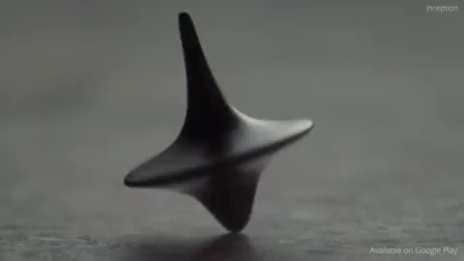
Hands off!
Disclaimer: this safety moment is designed to prevent similar incidents occurring. All guidance herein is provided in good faith and Step Change in Safety nor its member companies accept responsibility for any inaccuracies or omissions contained within this safety moment.

Slide 2
Hands off!
What was happening?
The riser assembly was being lifted by the rig floor tugger
The riser became jammed due to alignment issues
After the 2nd lift attempt, the supervisor tried to free the riser assembly using his foot, balancing himself by holding onto the wire
What could go wrong?

Slide 3

Hands off!
The wire rotated under load
When load was applied to the wire rope, it elongated and unwound – causing it to rotate
When load was released from the wire, it shortened and rewound – causing it rotate in the opposite direction

Slide 4
Hands off!
What happened?
The tugger operator attempted to lift the riser when the supervisor was holding the wire
The wire rotated rapidly, snagging the supervisor’s gloved hand
The supervisor lost a finger
Note: Wire rotation is a known issue, hence why a swivel was used in the lifting assembly

Slide 5
Hands off!
What led to this happening?
Toolbox talk: the risks of the rotating wire hazard was not raised – how could your toolbox talks be improved?
Normalisation of risk: the supervisor put himself in the line of fire – what do you do to keep out of the line of fire?
Communication failure: a lift was attempted whilst the supervisor was in the line of fire – how could you stop this happening?
No dynamic risk assessment: no-one stopped the job, even after two unsuccessful lifts – why do you think this happened?
Notes:
TBT – is it too noisy to hear properly, does everyone participate, are all hazards including major accident hazards discussed, who delivers TBTs – is it always the same person, what is done to test understanding after the TBT, are you aware of the SCiS material?
Normalisation of risk (when unacceptable risk becomes acceptable over a period of time) – what is ‘the line of fire’, could a handling tool have been used to separate the person from the hazard?
Communication failure – do you agree the communication arrangements up-front, do you check understanding of the job before the starting, what arrangements do you have in place for blind lifts?
Dynamic risk assessment – complacency, empowerment?

Slide 6
Hands off!
Which of the 7Cs are involved in this safety moment?
Change management
Communication
Complacency
Control of work
Competence
Culture
Commitment
Did this presentation result in discussion that could lead to creating another alert to share with industry? Please contact : info@stepchangeinsafety.net

