Slide 1
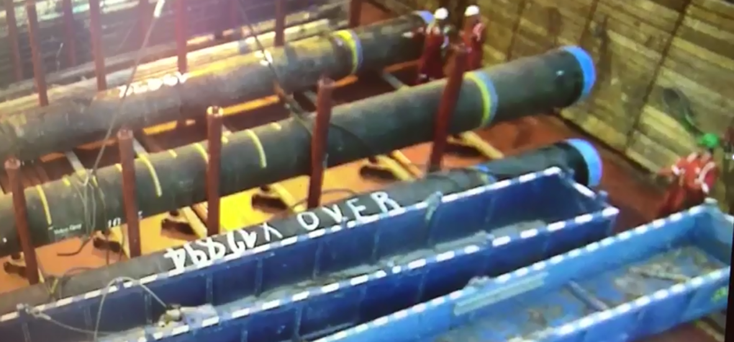
In the line of fire
Disclaimer: this safety moment is designed to prevent similar incidents occurring. All guidance herein is provided in good faith and Step Change in Safety nor its member companies accept responsibility for any inaccuracies or omissions contained within this safety moment.

Slide 2
In the line of fire
A crew were handling caissons (approx. 10 ton each) on an offshore installation
This was a routine operation
Environmental conditions were acceptable to carry out the task
The workparty consisted of a crane operator, a banksman and two load handlers
What could go wrong?

Slide 3
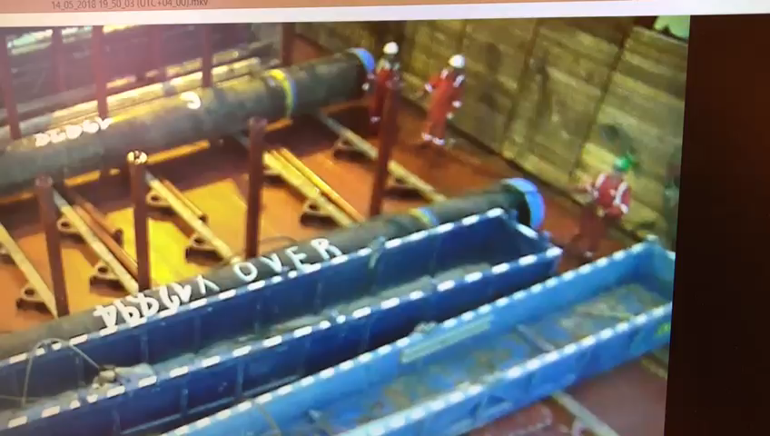
In the line of fire
Notes:
Play the video

Slide 4

In the line of fire
What went wrong?
Consider:
Positioning of personnel and use of safe havens – lack of spatial awareness
Communications – who was in charge, how are team members visually identified (e.g. different coloured vests)
Stop the job empowerment
Toolbox talk effectiveness
Planning of task
Site safety culture and acceptable practice – lack of supervision / leadership
Complacency – deviation from training
Perception of risk
Notes:
Positioning of personnel – two people we in the line of fire during this lift. It’s the banksman’s responsibility to ensure the workparty is out of the line of fire. Reinforce safe havens during toolbox talk.
Communications – two people were attempting to instruct the crane operator and direct the lift leading to confusion.
Stop the job empowerment – what prevented someone stopping the job? (particularly the banksman and crane operator)
Toolbox talk effectiveness – ask ‘how could we get hurt doing this job?’, does everyone understand roles and responsibilities, everyone actually taking past in the TBT, stop the job triggers, where are the escape routes and safe haven.
Planning of task – was the right plan being used? It was considered to be a ‘routine job’. Either poor planning or lack of implementation of plan (still discussing the job as the load is arriving)
Site safety culture – acceptable practice? were the rules being followed? Does the site culture tolerate deviation from procedures? Lack of task supervision/leadership.
Perception of risk – this was a routine task leading to potential complacency. Slow moving objects do not appear hazardous, despite their weight.

Slide 5
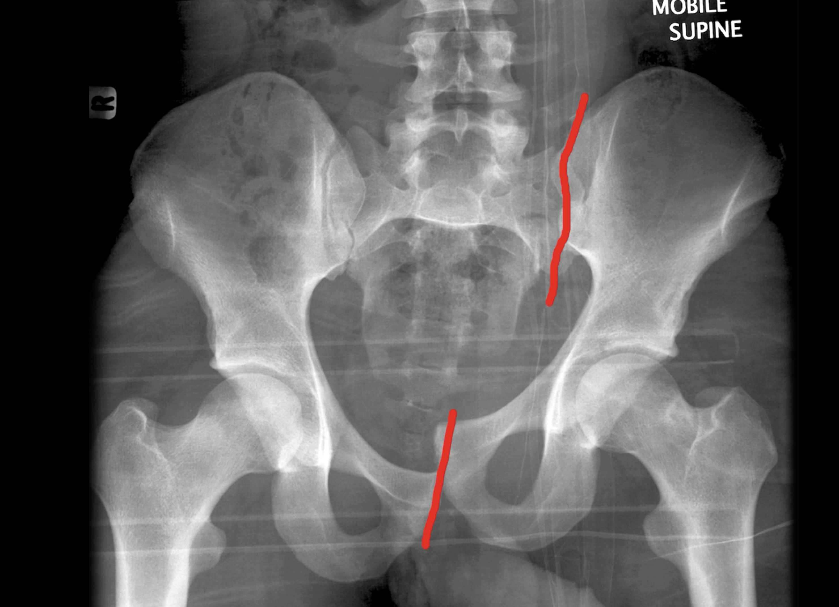
In the line of fire
Consequences
The injured person suffered a fractured pelvis and internal bleeding
Typically, this takes 6 weeks to heal
Could this happen at your worksite?

Slide 6
In the line of fire
Good practice:
Assurance of competence (task verification by site leadership and external)
Stop the job empowerment and visible safety culture
Company specific procedures – effective and reviewed
Effective toolbox talk (Step Change in Safety)
Tubular handling guidelines (Step Change in Safety)
Lifting and mechanical handling guidelines (Step Change in Safety)
Safe packing and handling guidelines (OGUK)
Banksman slinger pocket handbook (e.g. NSL, Sparrows)

Slide 7
In the line of fire
Which of the 7Cs are involved in this safety moment?
Change management
Communication
Complacency
Control of work
Competence
Culture
Commitment
Did this presentation result in discussion that could lead to creating another alert to share with industry? Please contact : info@stepchangeinsafety.net

