Slide 1
Safety Moment
Proactive leak detection
(using infra red techniques)
Disclaimer: this safety moment is designed to prevent similar incidents occurring. All guidance herein is provided in good faith and Step Change in Safety nor its member companies accept responsibility for any inaccuracies or omissions contained within this safety moment.

Slide 2
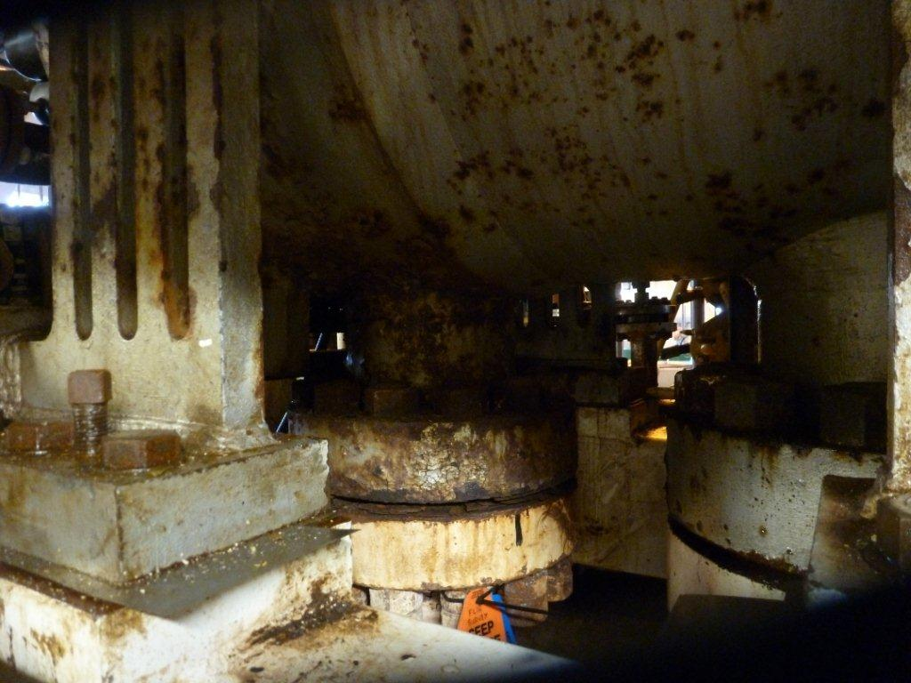
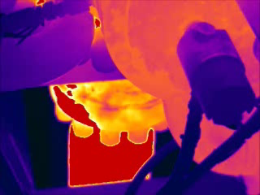
Discharge flange connection from high pressure gas compressor
During an infra red camera survey on a gas compressor, members of the workforce discovered a small leak coming from the high pressure discharge flange.
What would you do on your site? What should be done?
DISCUSS
Proactive leak detection
Notes:
Play the film (right hand side image)
The compressor operates at 140 Barg @ 86 Deg C
(car tyre pressure = 2 Bar = 30psi)

Slide 3
What happened:
An inspection crew was conducting a proactive inspection of a gas export system using an infrared camera which looks for very small leaks (fugitive emissions).
A small leak was observed around the flange using an infra red camera.
A gas meter was applied and readings confirmed >20% LEL (Lower Explosive Limit) mix of gas and air at 0.5m from the leak point.
It was decided there was a risk of this escalating to a larger, more hazardous leak.
Action taken:
A LEAK Aware tag was added to the flange.
An immediate decision was taken to shut down the gas compressor.
The leak was repaired and the unit was safety returned to service after testing.
Proactive leak detection
Notes:
Lower explosive limit (LEL) is the lowest concentration of gas or vapour in air capable of producing a flash fire in the presence of an ignition source.
>20% LEL at 0.5m means that this is a reportable hydrocarbon release under RIDDOR.

Slide 4
What arrangements do you have in place to find small leaks before they escalate?
How do you manage small leaks?
DISCUSS
Proactive leak detection

Slide 5
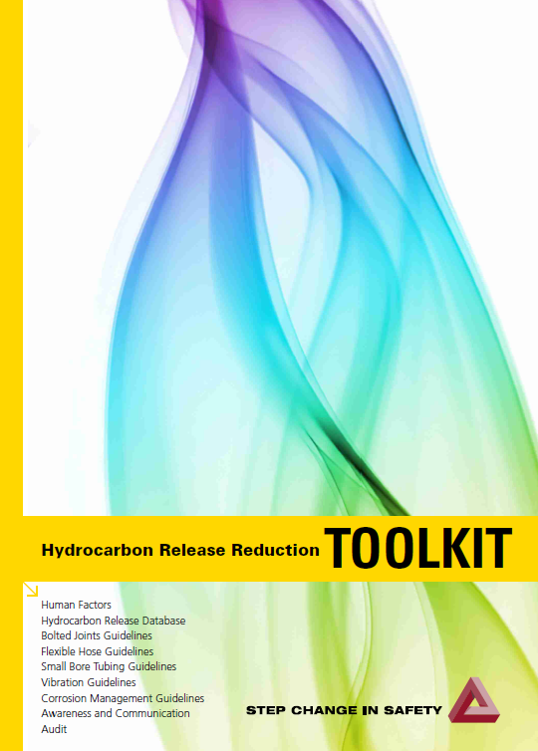
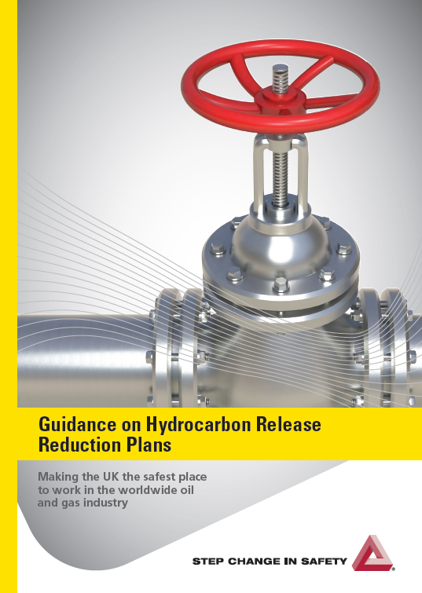
Help and Advice
Hydrocarbon releases from mechanical joints can be a symptom of corrosion, degradation of seals, vibration or incorrect design, fabrication or assembly. They usually become worse with time, so maintenance, a leak detection and reduction plan can lead to early discovery of potential threats to safety and production.
This allows us to:
Check the condition of seals and joints
Plan repairs
Avoid dangerous releases from developing
A formal area inspection procedure (where the team may smell, see or hear leaks) can also lead to proactive detection.
Information on infra red cameras can be found at: FLIR and EyeC gas.
Good practice guidance is available in Step Change.
Proactive leak detection
Notes:
Click on the document covers to take you to the documents on the Step Change website

Slide 6
Which of the 7Cs are involved in this safety alert?
Change management
Communication
Complacency
Control of work
Competence
Culture
Commitment
Did this alert result in a workplace discussion that lead to creating an alert? Please share with industry - contact: info@stepchangeinsafety.net
Proactive leak detection

