Slide 1
Making a meal of lifting operations
Disclaimer: this safety moment is designed to prevent similar incidents occurring. All guidance herein is provided in good faith and Step Change in Safety nor its member companies accept responsibility for any inaccuracies or omissions contained within this safety moment.

Slide 2
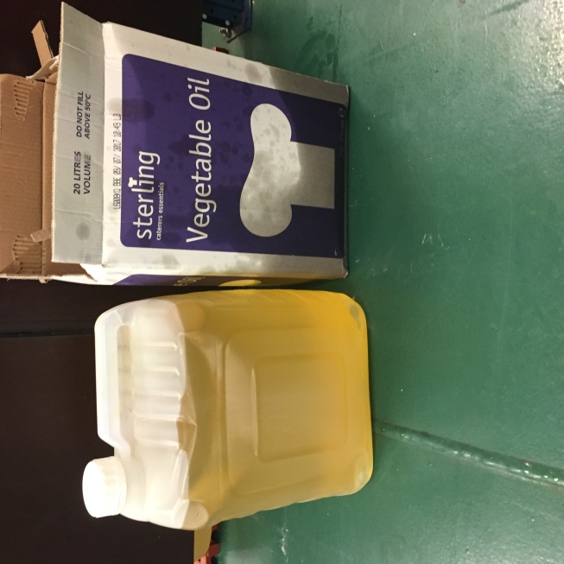
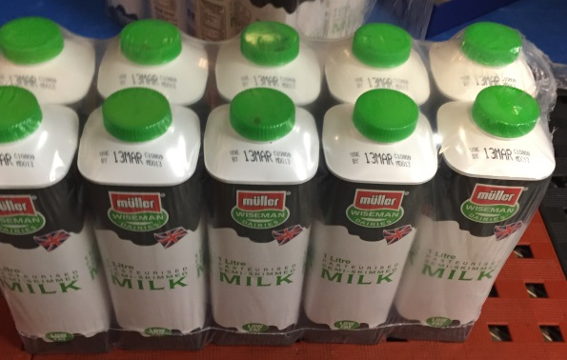
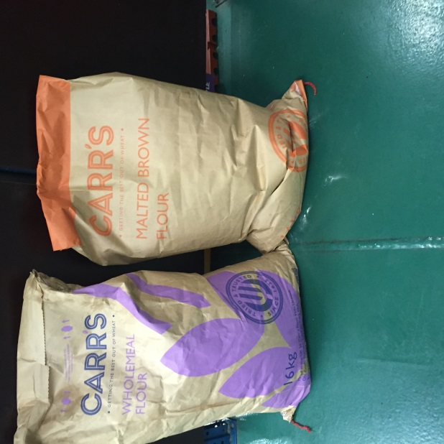
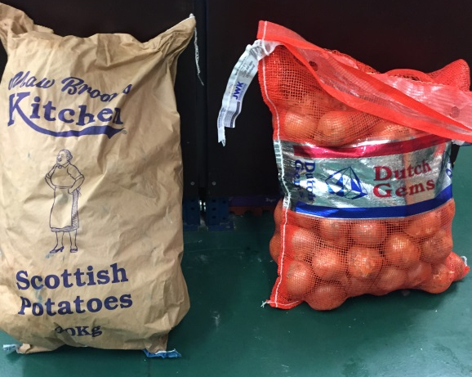
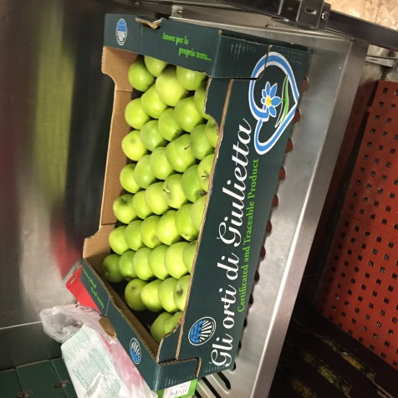

Lifting operations
12 bidons of cooking oil (24kg each)
14 bags flour (16kg each)
9 bags potatoes (20kg each)
5 bags onions (20kg each)
4 boxes apples (2.6kg each)
8 boxes milk (12kg each)
Total 900kg
A routine lift of 900kg pallet of food was to be lifted from the dockside, through a hatch, into galley stores
Several people involved in the lift did not attend or were late for the toolbox talk
Roles and responsibilities for the lift were not clear
Regardless of this, the lift went ahead
What could have happened?

Slide 3
Lifting operations
What happened?
1. The pallet collided with the corner of the hatch causing most of the 900kg to fall 7.2m to the deck area below
Banksman
Point of pallet contact
Deck 6
Upper hatch combing to lower hatch deck (7.2m)
2. The dropped load narrowly missed the storeman
Storeman
View from fwd of hatch loading area
Area fallen items landed
Deck 4
Path of storeman
Why might this have happened?

Slide 4
Lifting operations
What caused the incident?
The load wasn’t properly secured
Crane operator didn’t stop the job when he saw the load was unstable – he wasn’t comfortable challenging his supervisor
The load was still swinging when it entered the hatch – misunderstanding about who was in charge of the lift
Inadequate task risk assessment and lifting plan – no reference to pausing above the hatch
Task responsibilities not established because toolbox talk was not fully attended – people arrived late
How do you ensure this doesn’t happen at your worksite?

Slide 5
Lifting operations
Good practice guidance
‘Stop the Job’ culture is essential throughout the organisation
Everyone involved in a task should take part in the toolbox talk
Roles and responsibilities should be clear and understood before starting the job
Ensure lift plans and risk assessments are up-to-date, competently agreed and followed
Communicate with your team
Ensure time constraints do not affect safe operations
See Step Change in Safety document:
Lifting & Mechanical Handling Guidelines

Slide 6
Lifting operations
Which of the 7Cs are involved in this safety alert?
Change management
Communication
Complacency
Control of work
Competence
Culture
Commitment
Did this presentation result in discussion that could lead to creating another alert to share with industry? Please contact : info@stepchangeinsafety.net

