Slide 1
Safety Moment
Pressure release when breaking containment
Disclaimer: this safety moment is designed to prevent similar incidents. All guidance herein is provided in good faith and Step Change in Safety nor its member companies accept responsibility for any inaccuracies or omissions contained within this Safety Moment.

Slide 2
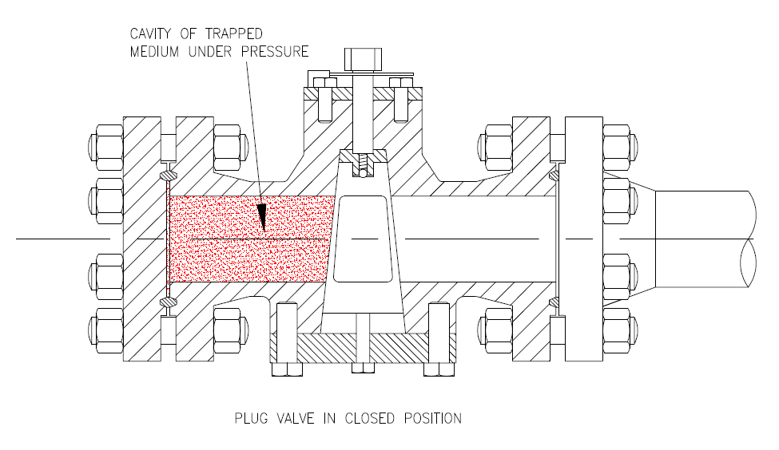
System previously depressurised
Trapped pressure – unknown to work party
Corroded bolts to be removed
Valve in closed position
A blind flange was being removed to replace corroded bolts. The valve was connected to a system which had been previously de-pressurised.
What hazards are there? What could go wrong? What might be the consequences?
DISCUSS
Pressure release when breaking containment

Slide 3
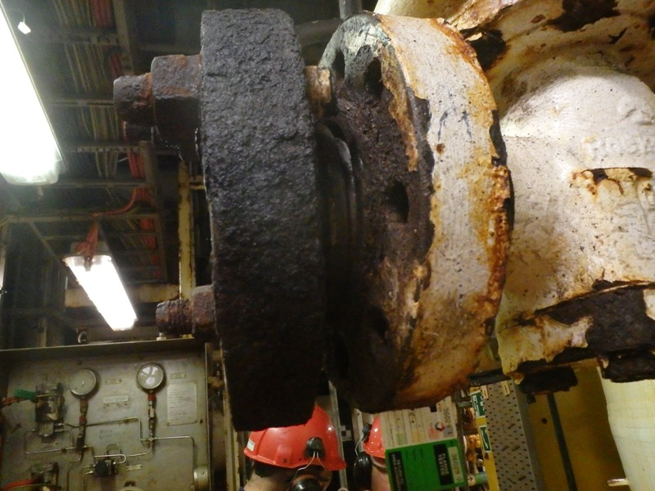
What happened:
There was a sudden uncontrolled release of pressure when the last retaining bolt was removed
The technician sustained eye and face injuries due to rust particles which penetrated his temple, eyes and cheeks
Why it happened:
The system had been depressurised, vented and drained during initial breaking of containment, and blank ends had been removed from the vessel with no indication of any pressure. Work had been on-going for two days and there was an assumption that there was no longer any pressure in the system.
However, there was trapped pressure between the flange and a closed valve.
Pressure release when breaking containment

Slide 4
What behaviours and steps could prevent this from occurring?
DISCUSS
What might you do differently today in your work?
Pressure release when breaking containment

Slide 5
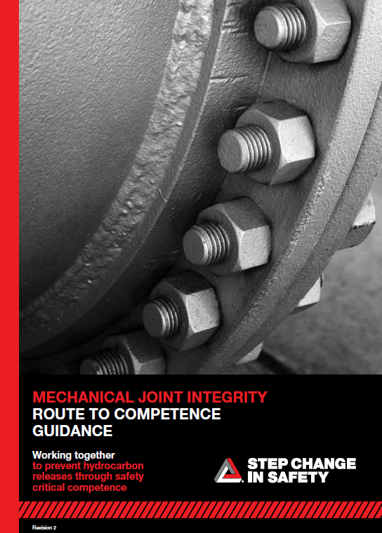
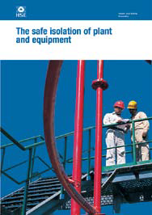

Help and advice
Depressurised systems can contain pockets of pressure. This should be covered during the Toolbox Talk to ensure all the team are aware.
The area operator/authority should be able to demonstrate that there is no pressure contained and monitor breaking containment.
Avoid complacency and approach every breaking of containment as if pressure might be present.
Control of Work processes and breaking of containment procedures must be followed.
Useful resources:
Pressure release when breaking containment
Notes:
Do you know of any other guidance and training that could be useful?
Mechanical Joint Integrity – Route to competence guidance
Safe isolation of plant and equipment HSG253
Joined-up Thinking: complacency, control of work, culture, competence, communication packs

Slide 6
Which of the 7Cs are involved in this safety alert?
Change management
Communication
Complacency
Control of work
Competence
Culture
Commitment
Did this presentation result in discussion? Please share your comments here.
Could your discussion lead to creating another alert to share with industry? Please contact : info@stepchangeinsafety.net
Pressure release when breaking containment
Notes:
Insert hyperlink

