Slide 1
Safety Moment
Re-spooling Line onto a Winch
Disclaimer: this safety moment is designed to prevent similar incidents occurring. All guidance herein is provided in good faith and Step Change in Safety nor its member companies accept responsibility for any inaccuracies or omissions contained within this safety moment.

Slide 2
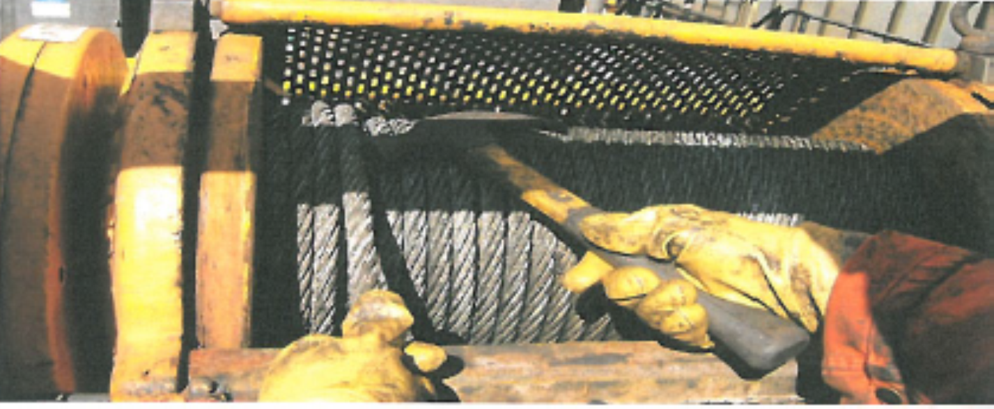
A wire was being re-spooled neatly onto a winch drum after work had been completed.
One man operated the winch and another guided the wire using two hands and a hammer.
What could go wrong? What could be the consequences?
DISCUSS
Re-spooling line onto winch

Slide 3
What happened:
As spooling progressed, the men became more confident and speed was increased.
The man’s left hand was caught by a broken wire and pulled towards the drum.
He did not call out to stop the winch as he thought he could free it before reaching the drum. The winch operator was not paying attention and continued to spool on the wire.
The wire-feeding hand and arm were pulled into the winch.
The man lost four fingers, and remained in hospital for seven days. He was unfit to work for more than a year.
Re-spooling line onto winch

Slide 4
What behaviours and steps would prevent this from occurring?
DISCUSS
What similar situations might you face?
What might you do differently today in your work?
Re-spooling line onto winch

Slide 5
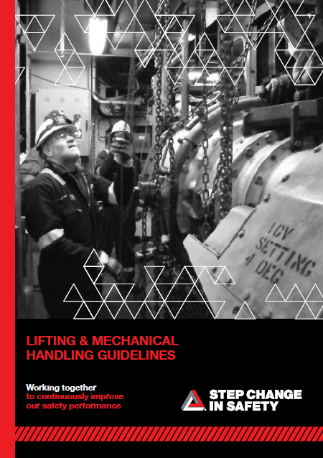

Good practice:
The job isn’t finished until all equipment is tidied up. Re-spooling of line should be included in the lift plan risk assessment (see guidance on Lifting and Mechanical Handling below)
Equipment is available to remove the need for hands on work (spooling equipment)
Promote a culture of stopping to consider how operations can be completed more safely, particularly when an unplanned activity arises
It is important to remain vigilant when working and recognise when people are exposing themselves to additional risks as a result of their actions
Useful resources:
Step Change Joined-up Thinking packs
Step Change Lifting and Mechanical Handing Guidelines
Re-spooling line onto winch

Slide 6
Which of the 7Cs are involved in this safety alert?
Change management
Communication
Complacency
Control of work
Competence
Culture
Commitment
Did this presentation result in discussion? Please share your comments here.
Could your discussion lead to creating another alert to share with industry? Please contact : info@stepchangeinsafety.net
Re-spooling line onto winch

