Slide 1
Safety Moment
SIMOPS
(Simultaneous operations)

Slide 2
Scenario
You are in charge of an unmanned wellhead platform
A drilling rig will be coming alongside in a few months to carry out simultaneous operations
What additional hazards might be introduced as a result of the two installations working together?
What aspects of your operation might change as a result of the two installations coming together?
DISCUSS
SIMOPS
Notes:
For additional hazards, consider:
Lifeboats, evacuations routes, firewater, vents, emergency shutdown, control of work, emergency disconnects, lifting operations, helicopter operations

Slide 3
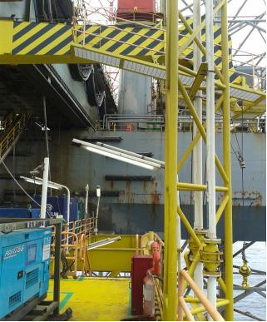
Let’s look at a real event
A normally unmanned wellhead platform with a jack-up drill rig in attendance
Wellhead platform (WHP) – normal production and operations
Jack-up drill rig – work over operations in progress
An operator on the WHP was routinely venting gas from a well through the cold flare
Drill rig
vent
WHP
What could happen?
DISCUSS
SIMOPS
Notes:
The drill rig is grey
The wellhead platform is yellow
The vent is the vertical white pipe in the yellow vent stack

Slide 4
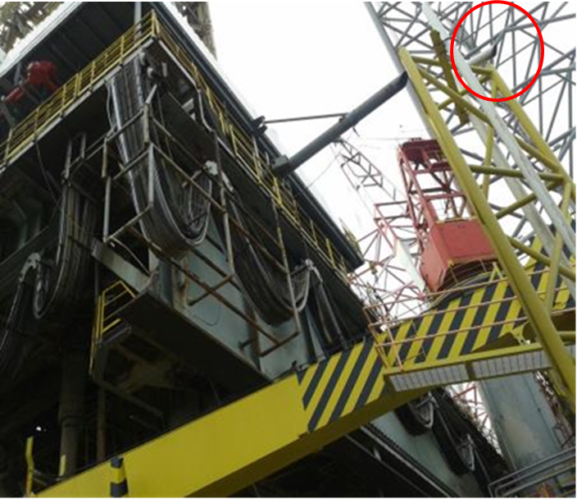
What happened:
In this case, gas was cold-vented from the wellhead platform over the jack-up
On the WHP, a well had stopped flowing and was shut-in
To restart the well an operator was asked to vent the topside’s gas from the shut-in well – this routine procedure did not normally need a Permit to Work.
The gas vent was located high on the wellhead but close to the attending jack-up
The jack-up OIM smelled gas, notified the drill rig control room and all hot-work was immediately suspended and systems made safe
SIMOPS

Slide 5
Fortunately the gas did not find an ignition source, no harm occurred and a potential major accident was prevented
What behaviours and steps could prevent this from occurring?
DISCUSS
SIMOPS

Slide 6
Factors which led to this incident:
Risk assessment not included for all activities
Routine operations were progressed without considering the presence of the jack-up drilling rig working over the installation
Simultaneous operations procedures were not adequately documented, understood or observed
People were complacent in performing routine hazardous operations
Help and Advice
SIMOPS: Two or more of the following activities: production, drilling, completion, workover, wireline (except routine operations) and major construction operations
During SIMOPS, it is vital that hazards are assessed and the joint safety needs are considered for all operations to avoid a hazard on one installation having an impact on the other(s)
Ensure effective communications are established between control of work authorities
SIMOPS
Notes:
The definition of SIMOPS comes from: API RP 54: Recommended Practice for Occupational Safety for Oil and Gas Well Drilling and Servicing Operations, Third Edition, August 1999 (2007)

Slide 7
Which of the 7Cs are involved in this safety alert?
Change management
Communication
Complacency
Control of work
Competence
Culture
Commitment
Did this presentation result in discussion that could lead to creating another alert to share with industry? Please contact : info@stepchangeinsafety.net
SIMOPS

