Slide 1
Safety Moment
Suspected gas leak
Disclaimer: This Safety Moment is designed to prevent similar incidents. All guidance herein is provided in good faith and Step Change in Safety nor its member companies accept responsibility for any inaccuracies or omissions contained within this Safety Moment.

Slide 2
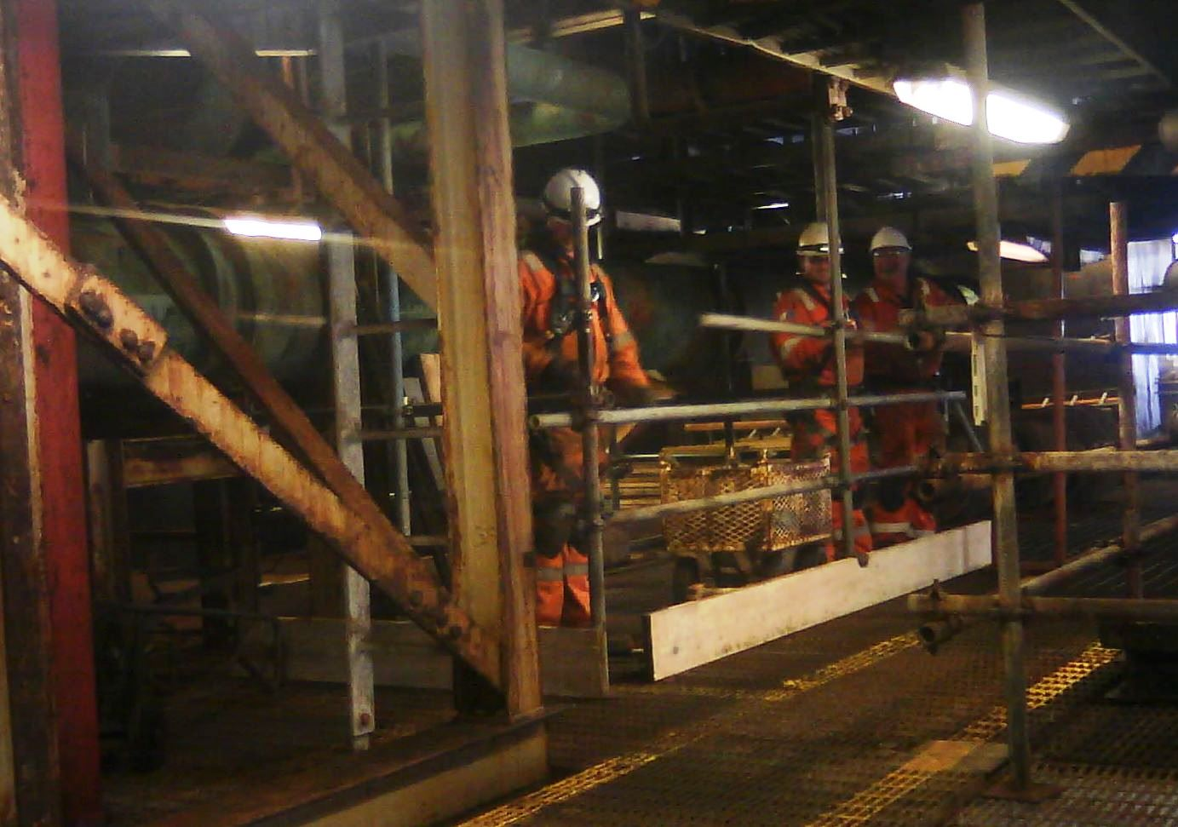
A team of scaffolders were working in a process plant
They heard and smelled something that they thought was a gas leak
Gas detectors had not detected anything
What would you do?
What could be the consequences of your action or inaction?
DISCUSS
Suspected gas leak

Slide 3
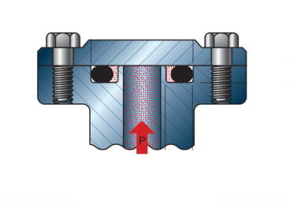
What happened:
The scaffolders contacted the control room immediately.
The leak was confirmed and the plant was safely shutdown.
The ventilation system dispersed the gas without creating an explosive gas cloud.
Investigation found that:
The leak came from a failed O-ring seal.
Gas detection didn’t detect the leak, possibly due to size or dispersion.
Electrical equipment in the area was correctly specified and maintained to ensure there was no ignition source.
Failed O-ring
Suspected gas leak

Slide 4
People who work around the plant all day can be the first to spot early signs of problems, for example:
          Unexpected noises or smells
          Vibration
          Corrosion or damage
What should you do if you detected a problem at your site?
What would happen if it turned out to be a false alarm?
What things are worrying you today?
DISCUSS
Suspected gas leak

Slide 5

Summary:
The scaffolders detected the leak before it could get worse and told the control room.
Even if they had been wrong, they did the right thing by reporting their concern.
Everyone who works around plant can spot early signs of problems.
Help and advice:
Suspected gas leak

Slide 6
Which of the 7Cs are involved in this safety alert?
Change management
Communication
Complacency
Control of work
Competence
Culture
Commitment
Did this presentation result in discussion that could lead to creating another alert to share with industry? Please contact : info@stepchangeinsafety.net
Suspected gas leak

