Slide 1
Safety Moment
Small bore tubing failure
Disclaimer: this safety moment is designed to prevent similar incidents occurring. All guidance herein is provided in good faith and Step Change in Safety nor its member companies accept responsibility for any inaccuracies or omissions contained within this safety moment.

Slide 2
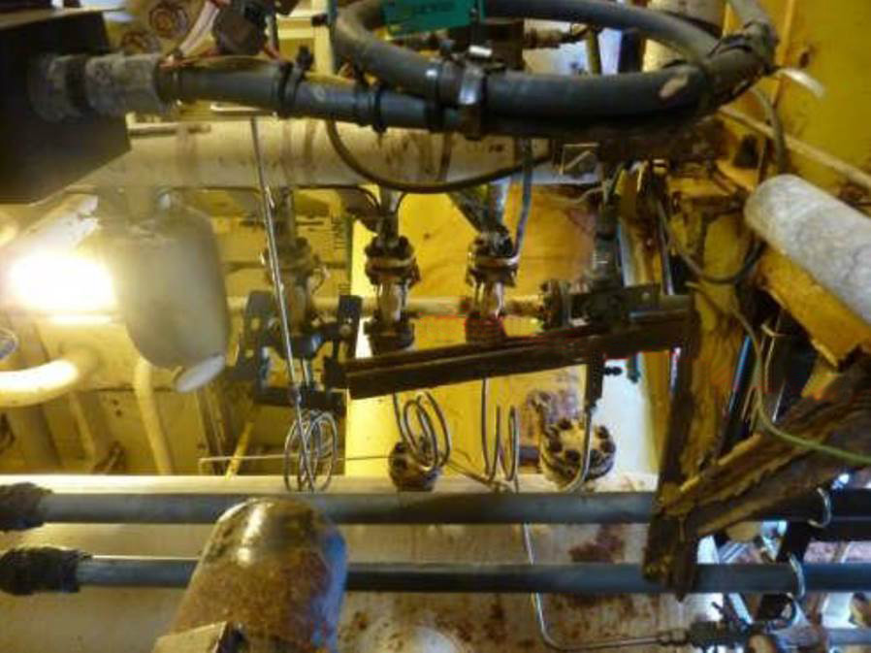
Reciprocating gas compressor with small bore tubing for instrument connections.
What hazards are there? What could go wrong? What might be the consequences?
DISCUSS
Small bore tubing failure

Slide 3
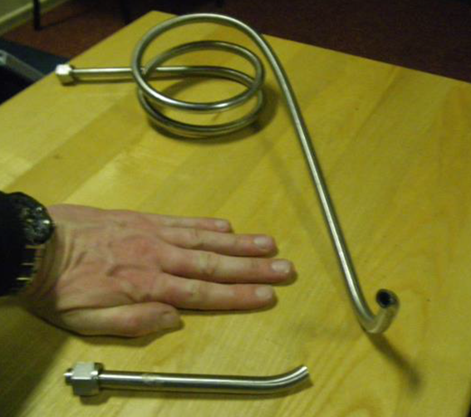
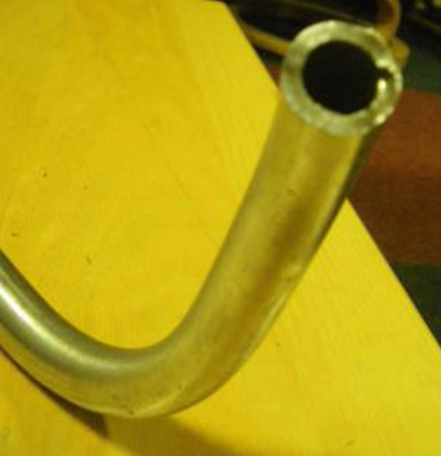
Fatigue failure of instrument tubing following reinstatement in an incorrect orientation using incorrect fitting practices
Following maintenance work, a small bore tubing run was re-instated upside down. The tubing was left with a pre-load stress and tool marks suggesting it was re-fitted using force.
Vibration from the compressor led to fatigue cracks emanating from the tool marks.
Full through thickness failure occurred. An estimated 1.67 Tonnes of gas was released over 83 min. Due to the open module configuration the gas was not detected by fixed detectors and the leak was manually detected by a routine inspection.
No ignition occurred.
Small bore tubing failure

Slide 4
What behaviours and steps could prevent this from occurring?
DISCUSS
What might you do differently today in your work?
Small bore tubing failure

Slide 5
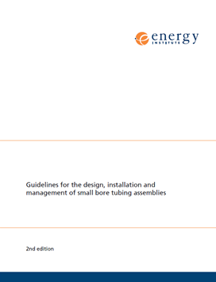
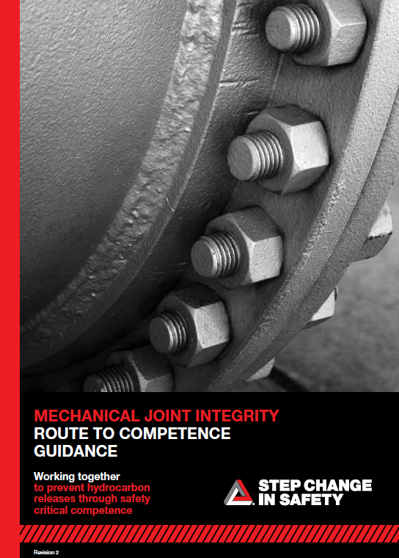

Help and advice
It is important that people are aware of causes of previous failures which could re-occur. Competence and knowing your limitations is essential when dealing with hazardous equipment. You will get more respect from people if you ask for their help when you are unsure. Making yourself open to help encourages others to ask, and helps protect us all.
Useful resources:
Energy Institute Guidelines – Guidelines for the design, installation and management of small bore tubing assemblies
Joined-up Thinking training packages SBT and Competence
Mechanical joint integrity – Route to competence
Small bore tubing failure
Notes:
Do you know of any other guidance and training that could be useful?

Slide 6
Which of the 7Cs are involved in this safety alert?
Change management
Communication
Complacency
Control of work
Competence
Culture
Commitment
Did this presentation result in discussion? Please share your comments here.
Could your discussion lead to creating another alert to share with industry? Please contact : info@stepchangeinsafety.net
Small bore tubing failure

