Slide 1
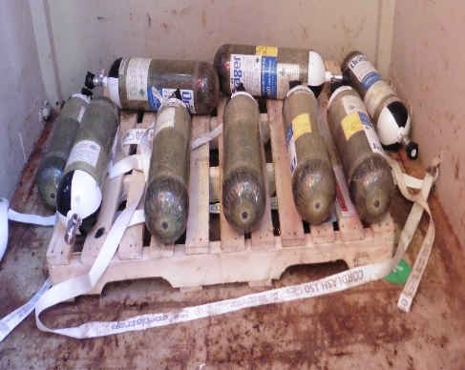
Under Pressure…
Transportation of compressed gas cylinders
Disclaimer: this safety moment is designed to prevent similar incidents occurring. All guidance herein is provided in good faith and Step Change in Safety nor its member companies accept responsibility for any inaccuracies or omissions contained within this safety moment.

Slide 2

Compressed gas transportation
Pressurised air cylinders used for breathing apparatus were being prepared for backloading onshore
A deck crew member was securing them by strapping them to a standard wooden pallet inside a container
What could go wrong?

Slide 3
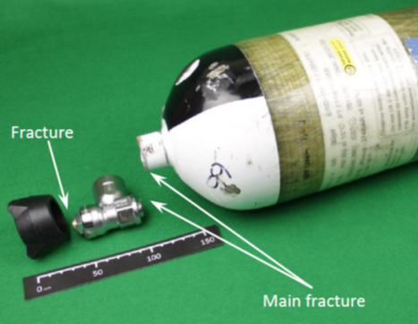
Compressed gas transportation
What happened?
One of the bottles fell
The valve fractured causing a rapid depletion of compressed air, resulting in the cylinder being propelled around the container, coming to rest outside the container on a walkway
The deck crew member suffered abrasion to his elbow
How are your cylinders transported?
Could this happen to you?

Slide 4
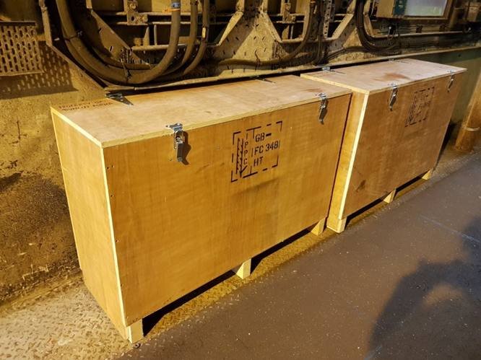
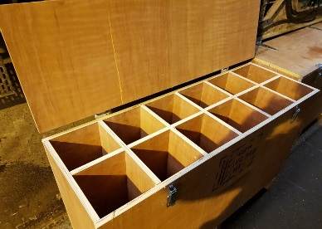
Compressed gas transportation
Learnings
The company developed special transportation boxes reducing the risk of cylinders being damaged
All valves were changed to a new safer type which release air in a controlled manner if the valve fails or is broken off
Would this make a difference at your worksite?

Slide 5

Compressed gas transportation
Do you ever look at a situation and see a better way of doing it?
Who do you share it with?

Slide 6
Compressed gas transportation
Which of the 7Cs are involved in this safety moment?
Change management
Communication
Complacency
Control of work
Competence
Culture
Commitment
Did this presentation result in discussion that could lead to creating another alert to share with industry? Please contact : info@stepchangeinsafety.net

