Slide 1
Corrosion of hollow sections
Disclaimer: this safety moment is designed to prevent similar incidents occurring. All guidance herein is provided in good faith and Step Change in Safety nor its member companies accept responsibility for any inaccuracies or omissions contained within this safety moment.

Slide 2
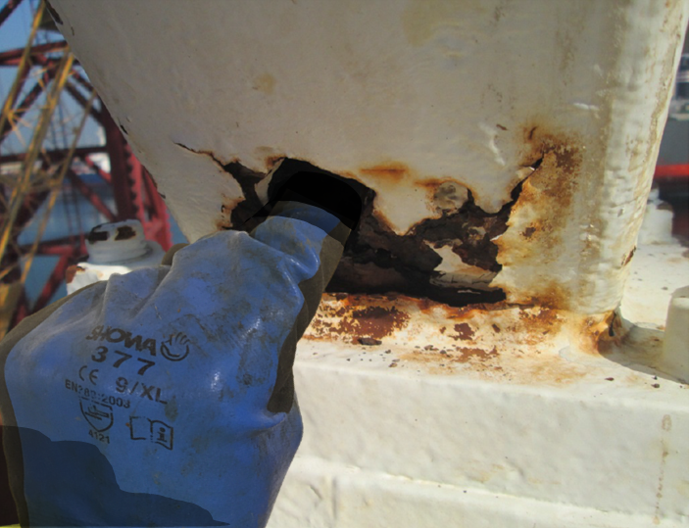

Corrosion of hollow sections
Drilling derrick structure
Hollow box section steel is susceptible to corrosion from the inside when water is allowed to get in from defects and modifications.
This is particularly important in load-bearing structures.
A structure like this could be supporting many hundreds of tonnes.
Have you seen something similar?
How would expect this to be detected?

Slide 3
Corrosion of hollow sections
Structural box section steelwork can corrode from the inside and can’t be seen until it’s too late.
A general visual inspection may not detect this.
Does your inspection type and frequency match corrosion mechanisms?
Be aware of the potential for water ingress from modifications e.g. unsealed holes
Report any signs of damage to your supervisor
Notes:
In this case, the internal corrosion in the structure had not been identified by previous inspections until the base metal was completely corroded, exposing holes in the members.
Hollow member box section may exist in a variety of locations on offshore platforms.
Discuss and share experience

Slide 4
Corrosion of hollow sections
What was discovered?
Analysis of this derrick showed structure was able to support only 40% of its original design capacity
Rig owner was unaware of corrosion or potential risk
Undetected corrosion of load bearing members inside hollow section could lead to structural failure resulting in major damage from collapse of structure
What condition is your hollow box section in?
Notes:
Corrosion of structural steel is just as important as pipework.
Hollow section can corrode from the inside out.
A suitable inspection programme should be scheduled and implemented to detect all potential corrosion mechanisms. Inspection regimes should be modified according to the stage of the asset life cycle.

Slide 5
Corrosion of hollow sections
Which of the 7Cs are involved in this safety alert?
Change management
Communication
Complacency
Control of work
Competence
Culture
Commitment
Did this presentation result in discussion that could lead to creating another alert to share with industry? Please contact : info@stepchangeinsafety.net

