Slide 1
If it looks wrong, maybe it is?
Notes:
This safety moment could also be entitled ‘Normalisation of Risk’ meaning we can become ‘normalised’ or accustomed to seeing situations which are unnecessarily dangerous eg damaged/degraded plant or corners cut.
The images in this presentation were taken from the Chemical Safety Board (CSB) videos. The CSB is an organisation that investigates incidents in USA. www.csb.gov/videos

Slide 2
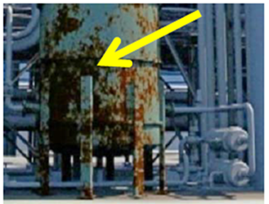

Preventing failures
That tank is severely corroded. Should I report it?
Notes:
Corrosion develops over time but a gradual change in appearance may not be recognised, as it seems the same as before, when it was acceptable

Slide 3
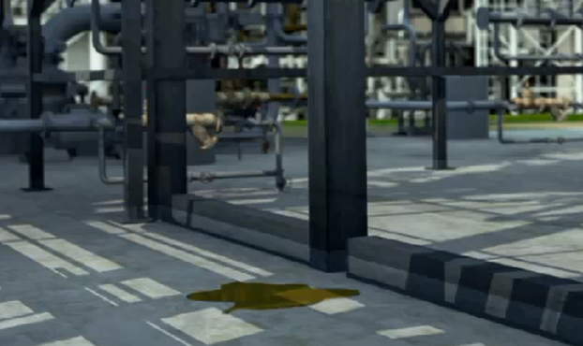
Preventing failures
That puddle has formed again – why?
What is causing it? Is there something needing fixed?

Slide 4
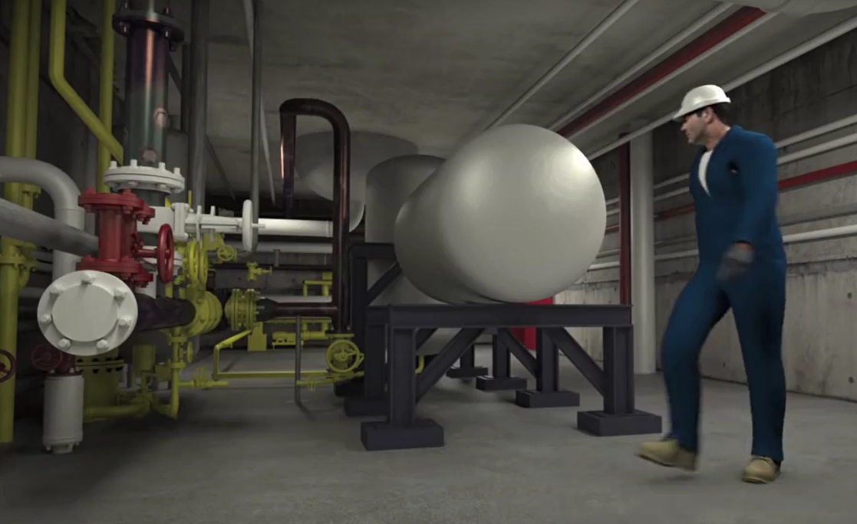
Preventing failures
That pipe has been vibrating for a while.
I wonder why? Is it acceptable?
Notes:
Vibration can lead to fatigue failure and loss of containment

Slide 5
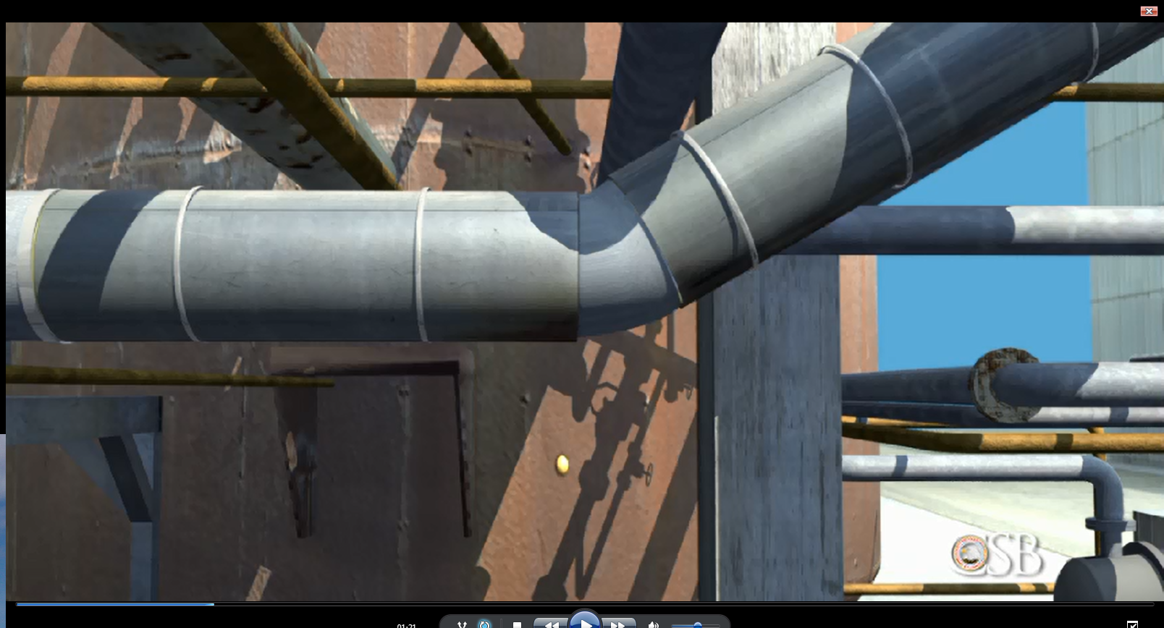
Preventing failures
Is something dripping from that insulated pipe?
Notes:
A dripping vessel or pipework could be the sign of a developing problem which could lead to hydrocarbon release.
Ice forming on a pipe may be the sign of a gas leak

Slide 6
Preventing failures
Tolerating small defects can lead to major incidents
Reasons for not doing anything | Reasons for doing something
Someone else must have reported it, it’s been like that for ages | If it doesn’t look OK, it may not be
It’s not up to me | It’s up to all of us to act
It must be ok as everyone else seems to think so | I can help my workmates by getting this fixed
It would mean more work for someone | It could prevent a future incident
I might look stupid if I raise that as a problem | We can make a safer workplace to be proud of

Slide 7
Preventing failures
What behaviours and steps could prevent this from occurring?
Don’t assume it’s right!
Make sure any reported defects by others are respected and recognised
Try changing your route as you walk through your plant to get a different view
Talk to others about any concerns and report it

Slide 8
Preventing failures
Which of the 7Cs are involved in this safety alert?
Change management
Communication
Complacency
Control of work
Competence
Culture
Commitment
Did this presentation result in discussion that could lead to creating another alert to share with industry? Please contact : info@stepchangeinsafety.net

