Slide 1

What lies beneath?
Disclaimer: this safety moment is designed to prevent similar incidents occurring. All guidance herein is provided in good faith and Step Change in Safety nor its member companies accept responsibility for any inaccuracies or omissions contained within this safety moment.

Slide 2
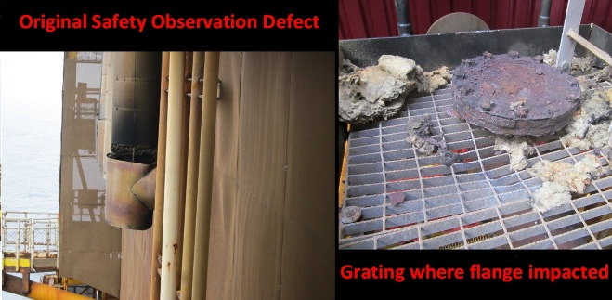

What lies beneath?
The exhaust stack
Exhaust fumes were being emitted from the bottom of the stack, coating the insulation in black, sooty deposits.
Black, sooty deposit
Insulation appears to have parted and dropped
An exhaust exiting a drilling module into a stack
What do you see?
What would you do?

Slide 3
What lies beneath?
The exhaust stack as built
insulation
Exhaust fumes from a diesel engine
blank flange
The insulation was hiding the underlying problem
An exhaust stack would normally be a welded sweeping curve without a flange
What hazards do you see in this design?
Notes:
Hazards could be CUI around the flange (water between the insulation and the flange)

Slide 4
What lies beneath?
The exhaust stack after some time
insulation
Exhaust fumes from a diesel engine
Detached blank flange
Cladding was hiding a 73kg 16” flange which had become detached due to bolt corrosion (corrosion under insulation – CUI) and was being supported only by the cladding
Notes:
73kg is approximately 11.5 stones

Slide 5
What lies beneath?
What happened next
The flange fell through the insulation and was found on the access platform which had not been barriered off
The 73kg flange had dropped 20m – a potential fatality according to the DROPS calculator
Can you think of any hidden problems at your worksite?
Grating where flange impacted
Notes:
This dropped flange could have killed someone. Additionally, it could have dropped on critical equipment and initiated a major incident.

Slide 6
What lies beneath?
Warning signs not addressed
Previous safety observations noted that the cladding looked like a potential dropped object
There were long-standing concerns raised that exhaust fumes were present in the drilling module
Assumptions made
Because it was an exhaust stack, it was assumed the pipework was a sweeping bend and not a T piece (drawing not checked and no investigations made) and it therefore did not pose an immediate drops threat
It was assumed that the drops threat was only cladding

Slide 7
What lies beneath?
Consider the following:
When a potential dropped object is identified, consider:
  What is concealed underneath cladding?
  What might fall?
  Where might it fall?
Any defect observation should include as much detail as possible to allow a full understanding of the situation
Do not make assumptions about the configuration and condition of plant under cladding – investigate fully

Slide 8
What lies beneath?
Which of the 7Cs are involved in this safety moment?
Change management
Communication
Complacency
Control of work
Competence
Culture
Commitment
Did this presentation result in discussion that could lead to creating another alert to share with industry? Please contact : info@stepchangeinsafety.net

