Slide 1

Deadlegs not only a hazard in football
Disclaimer: this safety moment is designed to prevent similar incidents occurring. All guidance herein is provided in good faith and Step Change in Safety nor its member companies accept responsibility for any inaccuracies or omissions contained within this safety moment.

Slide 2
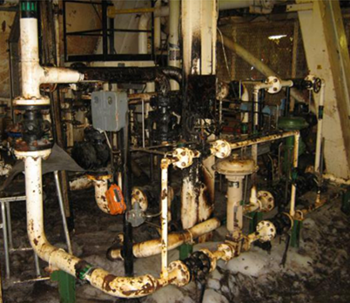

A hydrocarbon leak occurred in a processing module and gas detectors went into alarm.
An operator was sent to the module to investigate. He quickly became aware of the smell of gas and notified the CRO.
The duty CRO immediately shutdown the plant
What could be the causes of this hydrocarbon release?
Do these issues exist on your plant?

Slide 3
Potential causes of hydrocarbon releases
Small bore tubing connections
Flexible hose assemblies
Mechanical joints
Corrosion
Vibration/fatigue
Over-pressurisations
Failure to inspect / maintain
Failure to recognise and manage change

Slide 4
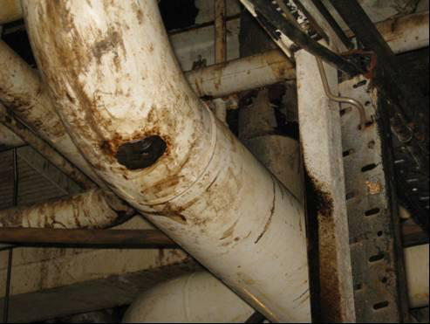

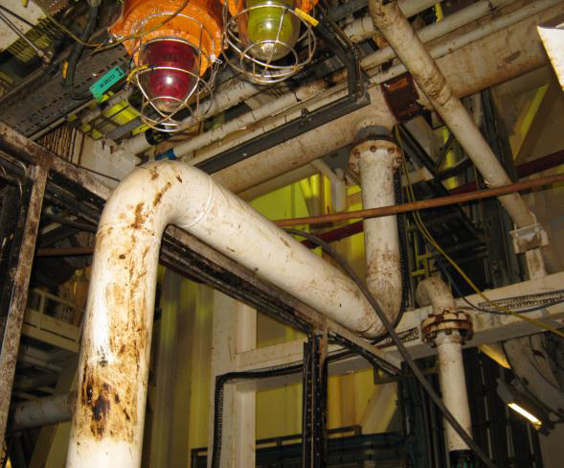

Deadlegs
Lessons learned
In this instance, the plant was made safe. An oil leak was traced to a ¼” diameter hole at the lower end of a pipework elbow.
The line was rarely used and had been left stagnant with liquid creating a deadleg corrosion trap.
Deadlegs can result in rapid corrosion and can arise as a result of:
design errors
the effects of normal operations
a change in designed operating mode
plant changes
How are deadlegs recognised and managed on your process plant?

Slide 5
Deadlegs
Good Practice
Be aware of the potential for operational deadlegs
Operations and maintenance
Be aware of changes to process plant operation.
Identify periods of significant stagnant operation in process lines with potentially corrosive fluids.
Ensure integrity personnel are consulted on Operational Risk Assessments (ORA) and Management of Change affecting the way pressure systems equipment is operated.
Integrity Engineers
Ensure risk-based inspection and integrity assessments account for threats of operational deadlegs and critical inspections are performed
Consider review of material selection for known problem areas
Ensure corrosion risk assessments and chemical management strategy are reviewed periodically

Slide 6
Deadlegs
Which of the 7Cs are involved in this safety alert?
Change management
Communication
Complacency
Control of work
Competence
Culture
Commitment
Did this presentation result in discussion that could lead to creating another alert to share with industry? Please contact : info@stepchangeinsafety.net

Slide 7
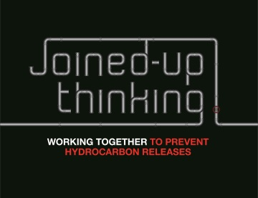
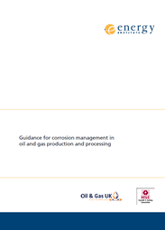
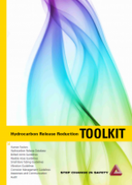
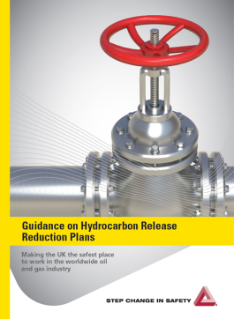
Deadlegs
Help and Advice:
Energy Institute ‘Guidance for corrosion management in oil and gas production and processing’ provides good insight into the hazards of deadlegs, how they can be avoided and managed
Step Change in Safety – Asset Integrity Toolkit
Step Change in Safety – Guidance on Hydrocarbon Release Reduction Plans
Step Change in Safety – Joined-up Thinking Communication pack
Energy Institute – Corrosion Threats Handbook

