Slide 1
Safety Moment
Evacuation
Disclaimer: this safety moment is designed to prevent similar incidents occurring. All guidance herein is provided in good faith and Step Change in Safety nor its member companies accept responsibility for any inaccuracies or omissions contained within this safety moment.

Slide 2
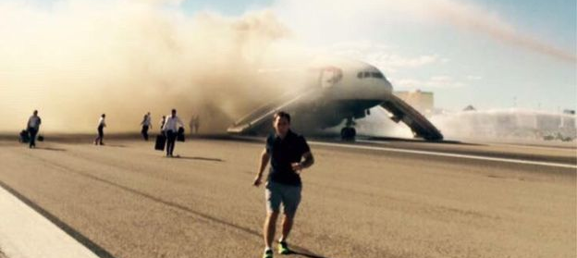
The plane was engulfed in flames and smoke as it prepared for take of, as a result of what the airline said was a technical issue.
What issues do you see? What could go wrong?
What might be the consequences?
DISCUSS
Evacuation
Notes:
Whilst preparing for take off, an engine of this British Airways flight from Las Vegas caught fire.

Slide 3
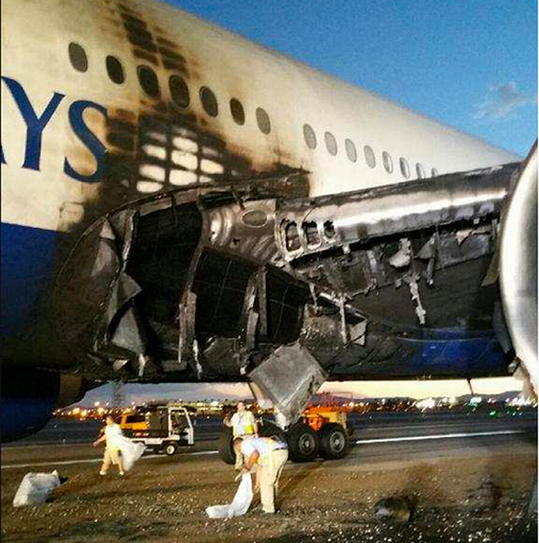
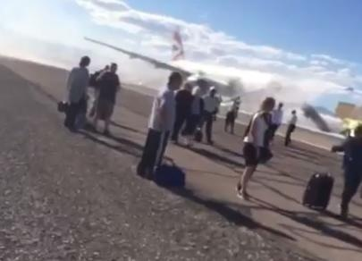
What happened
At least 14 people were treated for minor injuries following the incident on 8th September 2015 in Las Vegas.
Smoke entered the cabin when one exit was opened. This exit was declared unsafe and immediately closed, resulting in one less emergency exit.
Identified issues
Passengers ignored safety protocols and grabbed their bags before exiting.
Wheeled cases could have ripped the escape slides, rendering them unusable and preventing a safe exit.
Cases in the aisle make a confused situation even worse.
What might you have done in this situation?
Evacuation
Notes:
159 passengers and 13 crew on board.

Slide 4
Where else might you need to consider how you evacuate?
How will you plan your evacuation?
DISCUSS
What could you start doing differently today?
Evacuation

Slide 5
Help and advice
Think through your personal plan for evacuating from:
Worksites, offices, your home, planes, helicopters, trains, inaccessible or confined locations.
At your workplace do you have…?
A clear passageway to all escape routes
Clearly marked escape routes that are as short and direct as possible
Enough exits and routes for all people to escape
Emergency doors which open easily
Emergency lighting where needed
Training for all employees to know and use the escape routes
Provision for people who need assistance
A safe meeting point for staff
Evacuation
Notes:
Listen to the safety brief.
Treat every evacuation with urgency. It may not appear life-threatening but incidents can escalate very quickly.
In a plane, count the number of seats to the emergency exit in case smoke prevents you from seeing and/or the emergency lights are not working.
In a hotel, always check your nearest fire escape out of the building and count how many doors you must pass to reach the emergency exit.
Consider having a back-up plan – your most immediate route may be blocked
Consider the safety of others – do not impede their evacuation by taking personal belongings

Slide 6
Which of the 7Cs are involved in this safety alert?
Change management
Communication
Complacency
Control of work
Competence
Culture
Commitment
Did this presentation result in discussion that could lead to creating another alert to share with industry? Please contact: info@stepchangeinsafety.net
Evacuation

