Slide 1
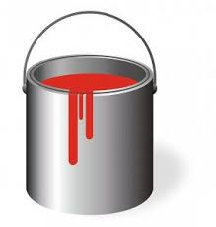
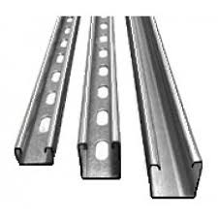
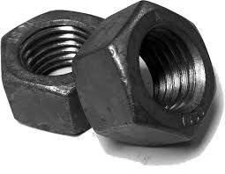
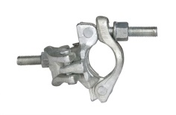
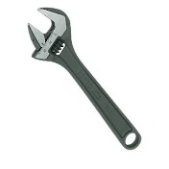
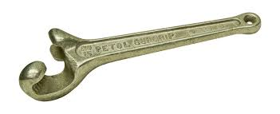
Oops
I left it again?
Disclaimer: this safety moment is designed to prevent similar incidents occurring. All guidance herein is provided in good faith and Step Change in Safety nor its member companies accept responsibility for any inaccuracies or omissions contained within this safety moment.

Slide 2
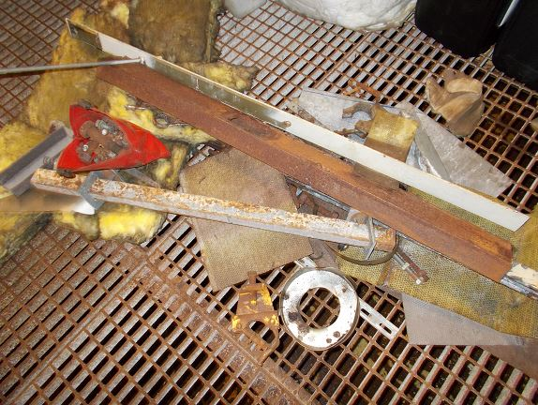
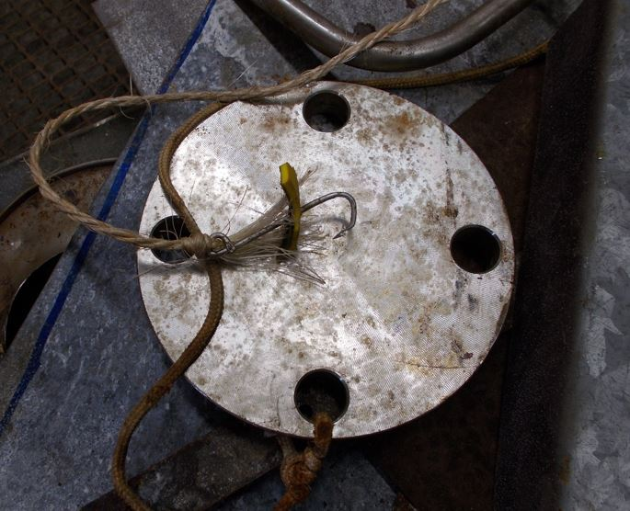
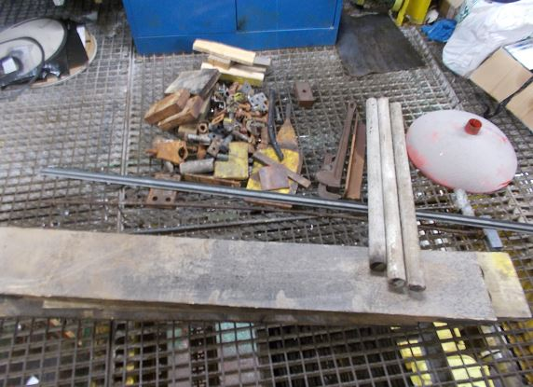
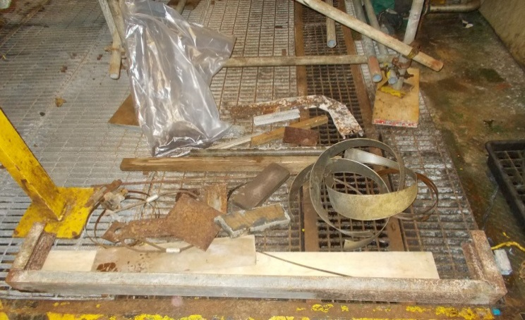
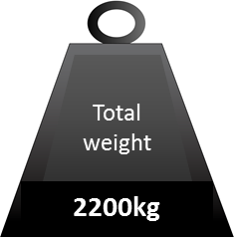
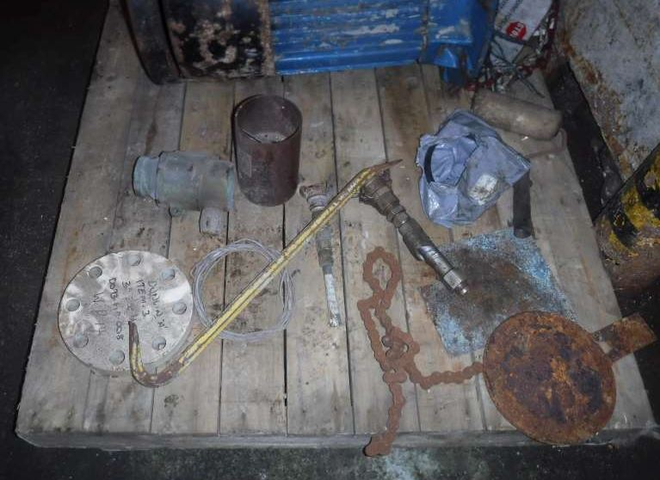
Dropped objects
These items were found during one platform clean-up campaign in 2016 and were all potential dropped objects

Slide 3

Dropped objects
The combined weight of the loose items removed from that installation is the same as the combined weight of these two cars
= 2.2 tonnes

Slide 4
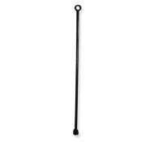
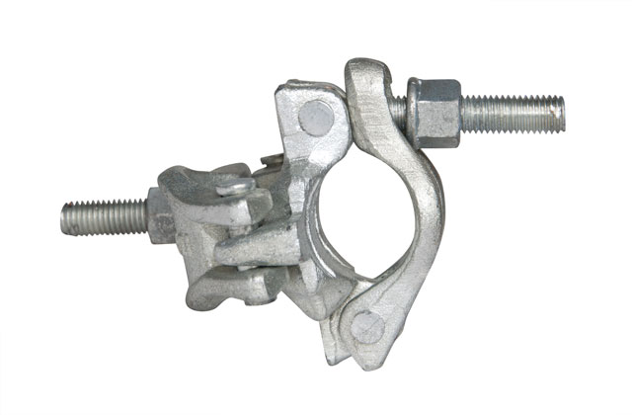
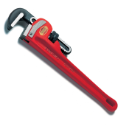

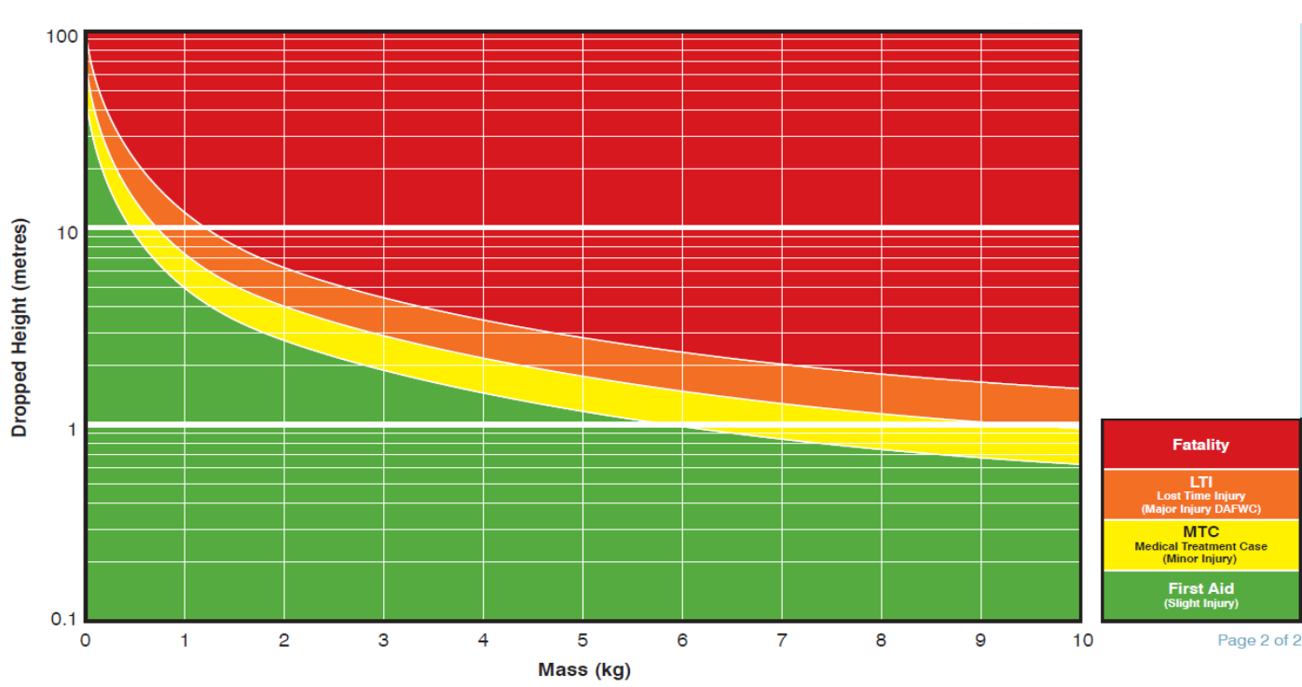

Dropped objects
The DROPS Calculator – how much harm can a dropped object cause?
1” tubular valve
cheater bar
Scaffold
clamp
Paint
pot
Scaffold spanner
Stillson
Pipe
wrench
1.5”nut
Have you ever left any of these behind?

Slide 5


Dropped objects
From what height must objects fall to result in injury and medical treatment?
When the objects appears, estimate their weight and discover what height they could drop from to cause medical treatment (the yellow area)
Scaffold
spanner
Scaffold
spanner
?
10metres 0.5kg

Slide 6
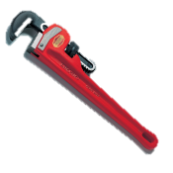
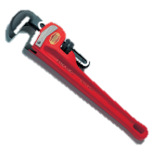
Dropped objects
From what height must objects fall to result in injury and medical treatment?
When the objects appears, estimate their weight and discover what height they could drop from to cause medical treatment (the yellow area)
24” Stillson pipe wrench
24”
Stillson
Pipe wrench
2 Metres 3kg
?

Slide 7
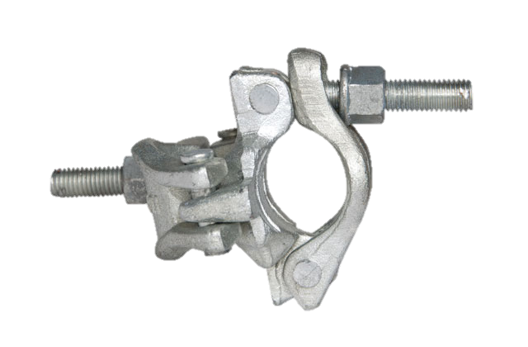
Dropped objects
From what height must objects fall to result in injury and medical treatment?
When the objects appears, estimate their weight and discover what height they could drop from to cause medical treatment (the yellow area)
Scaffold Clamp
Scaffold Clamp
?
5 metres 1kg

Slide 8
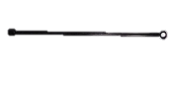
Dropped objects
From what height must objects fall to result in injury and medical treatment?
When the objects appears, estimate their weight and discover what height they could drop from to cause medical treatment (the yellow area)
1” tubular valve cheater bar
1” tubular valve cheater bar
1 Metre 7.6kg
?

Slide 9
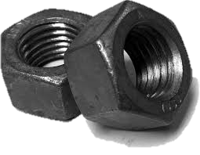
Dropped objects
From what height must objects fall to result in injury and medical treatment?
When the objects appears, estimate their weight and discover what height they could drop from to cause medical treatment (the yellow area)
1.5”nut
1.5”nut
10metres 0.5kg
?

Slide 10
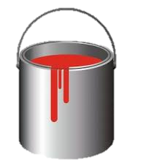
Dropped objects
From what height must objects fall to result in injury and medical treatment?
When the objects appears, estimate their weight and discover what height they could drop from to cause medical treatment (the yellow area)
1.5metres 4kg
?
2.5 litre Paint pot
2.5 litre Paint pot

Slide 11
Dropped objects
How’s our industry doing?
Source: DORIS.DROPS online
Activity breakdown of 661 incidents
between May 2011 and May 2016
Notes:
The number of dropped objects during different oil & gas operations worldwide
Source: www.dropsonline.org

Slide 12
Dropped objects
What type of objects are falling?
Source: DORIS.DROPS online
Activity breakdown of 661 incidents
between May 2011 and May 2016
Notes:
The type of dropped items in oil & gas operations worldwide
Source: www.dropsonline.org

Slide 13

Dropped objects
Dropped objects affect every stage of an installation’s lifecycle.
Particular attention should be paid during times of change, e.g. commissioning, shutdowns, modifications, following severe weather events, decommissioning and in areas of infrequent use.
How well are we doing?
When did we last do a sweep of our installation?
Are worksites in a tidy condition when we start work?
When we finish a job, do we always clear up? If not, what prevents us?
How will you prevent dropped objects occurring?
Notes:
What is left behind could be the next dropped object and could cause harm to others
Pay particular attention to placing and leaving tools in forklift pockets, scaffold tubes, on top or containers and on unistrut

Slide 14
Dropped objects
Which of the 7Cs are involved in this safety moment?
Change management
Communication
Complacency
Control of work
Competence
Culture
Commitment
Did this presentation result in discussion that could lead to creating another alert to share with industry? Please contact : info@stepchangeinsafety.net

