Slide 1
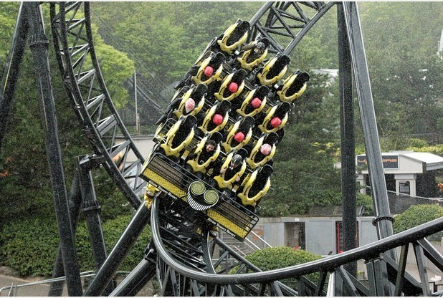
Theme Park Ride Crash
Disclaimer: this safety moment is designed to prevent similar incidents occurring. All guidance herein is provided in good faith and Step Change in Safety nor its member companies accept responsibility for any inaccuracies or omissions contained within this safety moment.

Slide 2
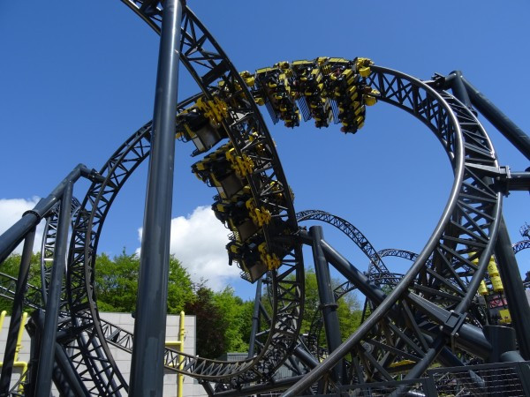
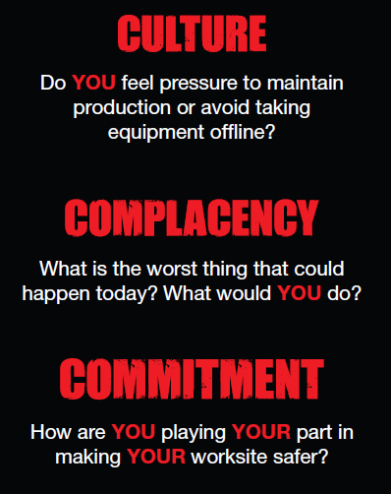
Theme park crash
Since opening, the Smiler ride had run more than 3 million times without a reported major incident
2nd June 2015, just another day at Alton Towers…
After stopping the ride for wind, empty carriages were sent around the track and one was inadvertently left in the ‘Pit’ section unseen by staff who didn’t know how many carriages were on the track at that time
Operations were restarted and, when the first carriage with 16 passengers reached the top of the lift hill, the computer stopped the ride because it recognised that there was a stationary carriage on the track

Slide 3
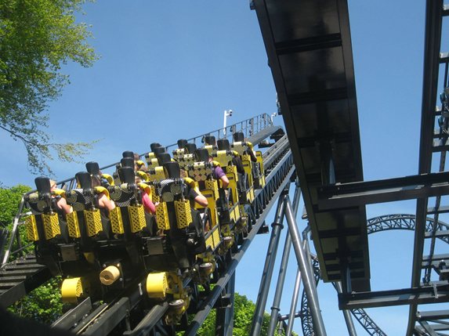

Theme park crash
Whenever a ride stops there is a clock in the control room which indicates how long the ride is non-operational. The bonus payment is dependent on low levels of downtime
The ride is operated by a team of five. The ride control room operator was 19 years old
There were 800 people in the queue
After carrying out checks, the computer was manually over-ridden and the ride was allowed to continue
Pressure to continue operating?

Slide 4
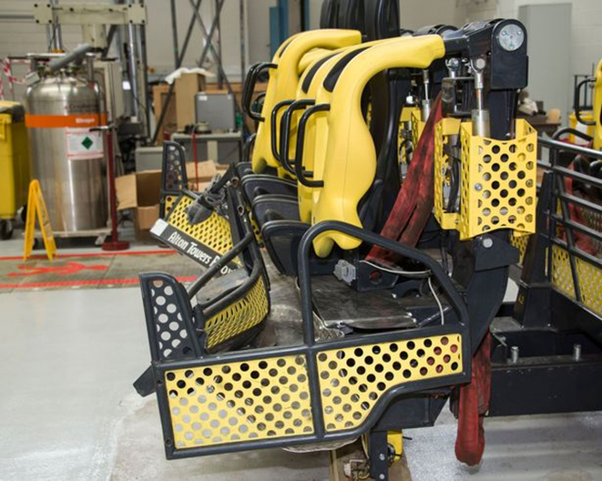
Theme park crash
Consequences
The carriage with 16 passengers crashed into the stationary one, resulting in severe injuries to many
This was equivalent to a family car of 1.5 tons colliding at about 90mph

Slide 5
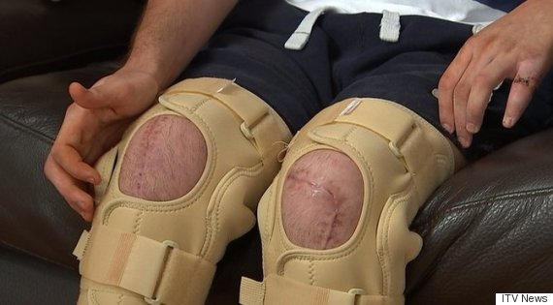
Theme park crash
More than 11 people suffered life changing injuries

Slide 6
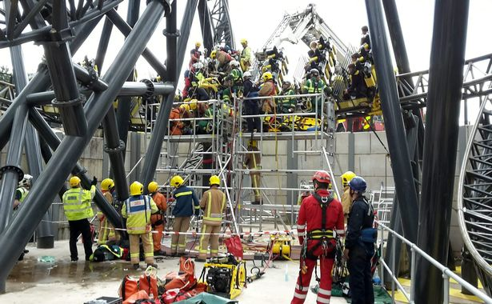
Theme park crash
Emergency Response
No detailed emergency response plans existed
Emergency services weren’t called until 17 mins after the crash
The emergency services could not get to the injured. There was a large concrete wall around the ride preventing mobile access equipment
They had to phone scaffolding companies
It took 5 hours to get the most injured down

Slide 7
Theme park crash
Incident Findings
The internal investigation concluded that the incident was the result of human error culminating in the manual override of the ride’s safety control system, without the appropriate protocols being followed
The HSE investigations identified many failings by the employer. “This avoidable incident happened because [the operating company] failed to put systems in place to prevent ‘human error’”
The court found that human error was not the cause and that the underlying fault was the absence of a structured and considered system. The operating company was fined £5million with civil cases to follow

Slide 8
Theme park crash
Time/bonus pressure:
Do you feel pressure to take short cuts?
How do you challenge unsafe situations?
Procedures:
Do you always follow them?
Are they fit for purpose?
Manual over-ride:
Do you know the potential consequences of over-rides?
How are over-rides at your worksite controlled?
Emergency Response:
Do you know if your ER plans are fit for purpose?

Slide 9
Theme park crash
Which of the 7Cs are involved in this safety alert?
Change management
Communication
Complacency
Control of work
Competence
Culture
Commitment
Did this presentation result in discussion that could lead to creating another alert to share with industry? Please contact : info@stepchangeinsafety.net

