Slide 1
Safety Moment
Condensate leak

Slide 2
Plant flowrates have changed recently, and there has been high levels of vibration on the pipework on the main outlet of the condensate separator.
On at least two previous occasions the position indicator on the Level Control Valve has gone into fault, preventing the control room operator (CRO) from seeing the actual position of the level control valve. So far they have managed their way around this.
Level Transmitter
Condensate separator
LT
Main condensate line
Vibrating pipework
Emergency Shutdown Valve (ESDV)
What hazards do you see?
What could go wrong?
What might be the consequences?
2” (50mm) line (equalises pressure across ESDV at start-up)
Level Control
Valve (LCV)
DISCUSS
Condensate leak

Slide 3
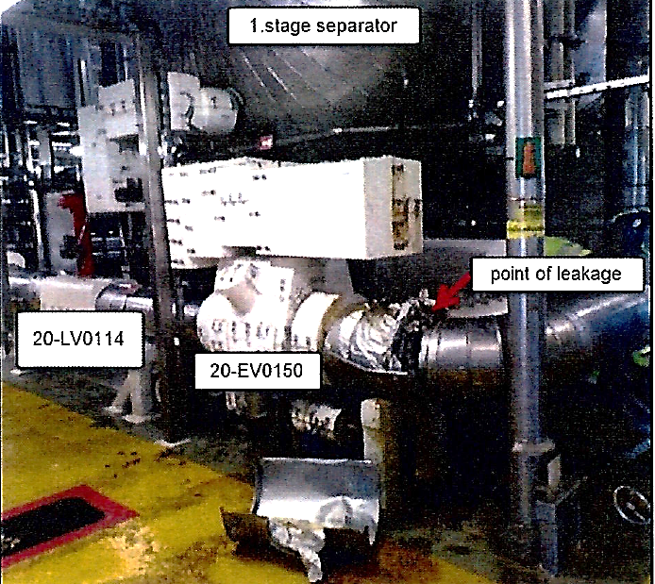
What happened
The LCV was not designed for the current flowrates, leading to vibration
Vibration caused a crack in the 2’’ line connected to the condensate outlet,
Condensate leaked out at ~8 kg/second. It took 90 minutes for flow to stop, as the leak was on the separator side of the closed ESDV.
Identified issues
There was a design failure
People had become accustomed to the vibration
There was a lack of specialist competence to select the right size of valve
There was a lack of operations input to projects on valve issues and design
Level Transmitter
Condensate separator
Condensate separator
LT
Crack and leak
Vibrating pipework
Crack and leak
2” line
LCV
ESDV
ESDV
LCV
Condensate leak

Slide 4
What operating conditions are you tolerating
that could be hazardous?
DISCUSS
Is there vibrating hydrocarbon plant that concerns you?
What might you do differently today in your work?
What could you look for when out on site?
Condensate leak

Slide 5


Help and advice
Recommendations for learning:
Vibrating pipework is a warning sign – don’t live with it
Vibration can result from original design as well as changing plant conditions
Creeping change can be difficult to spot – people can become accustomed to defective conditions. Are you accepting normalisation of deviation?
Managing vibration requires engineering advice – constraining vibrating pipework can cause failure
A Step Change Joined-up Thinking video on small bore tubing issues is available
A guidance document for the avoidance of vibration induced fatigue failure in process pipework
Is there anything else you would do?
Who can you go to in your organisation for help with vibration?
Condensate leak
Notes:
The Step Change logo is hyperlinked to the small bore tubing video and is free to members
Energy Institute logo is hyperlinked to the Energy Institute website. Note: non-Energy Institute members will be charged to download the document.

Slide 6
Which of the 7Cs are involved in this safety alert?
Change management
Communication
Complacency
Control of work
Competence
Culture
Commitment
Did this presentation result in discussion that could lead to creating another alert to share with industry? Please contact : info@stepchangeinsafety.net
Condensate leak

